Slide 1




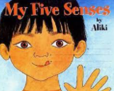
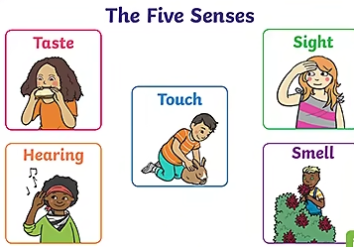
YEAR 1 SCIENCE – SENSES and our bodies– Spring 1
Tier 3 Vocabulary | Knowledge Facts | Book Curriculum & Recommended Reads
Senses - what help us to understand and interact with the world we live in. | The weather is spring starts to get warmer. The days start to longer and we get more daylight than autumn and winter. | .
Human body - The human body is the body of a person.
 | A human body has a head, eyes, ears, nose, mouth, ears, arms, shoulder, elbow, hand, fingers, body, legs, knee, feet and toes.
Taste – a person's like or dislike for particular flavours.
 | Our eyes help us to see. They are important because they help us to see the world around us. Our ears help us to hear.
Smell - noticing smells or scents by means of the organs in the nose.
 | Taste buds are found on your tongue and allow you to experience tastes that are sweet, salty, sour, and bitter. We use our nose to smell things.
Touch - our skins can detect a wide range of different textures and temperatures.
 | Our skin helps us to feel the sense touch. Skin is the largest organ as it is found throughout the human body.
Hear - to be able to become aware of sound
 | National Curriculum End Points I can identify, name, draw and label the basic parts of the human body and say which part is associated with each sense.
Sight - the ability to see; vision.
.

