Slide 1
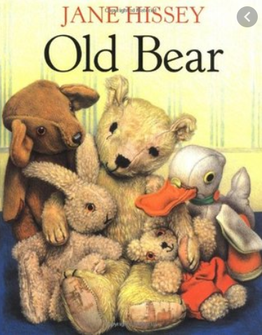
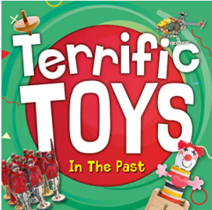
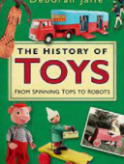
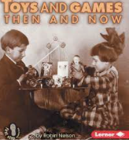
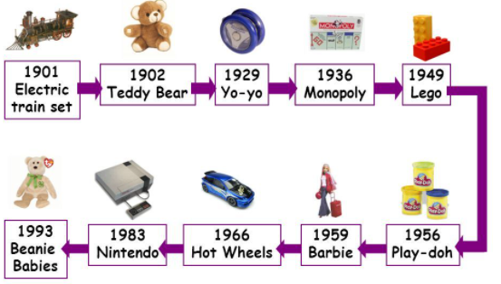
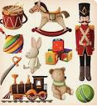
YEAR 1 HISTORY – TOYS – Spring 1
Tier 3 Vocabulary | Knowledge Facts | Book Curriculum
Timeline - A timeline is a tool that organises information. It is used to describe the order in which events happened. | My toys are usually made from plastic or are electrical. The toys from the present are mostly made in a factory.
 | My Grandparents toys were usually made from wood or metal. A lot of toys were usually hand made.
Event - An event is usually an important happening or has happened,
 | Place the toys on a timeline. Order them from the oldest toys created to the most recent toys created.
 |  | Other Recommended Reads
Artefacts - an object made by a human being, typically one of cultural or historical interest.
 | Toys in the past were usually made from wood, metal, glass and fabric. Toys made in the present are often made from plastic or they are electrical and need batteries.
Creation - the action or process of bringing something into existence.
 | Toys have changed over time. There are many differences between toys of the past and present including: the materials used, how they are played with and rules for how toys need to be made.
Modern - relating to the present or recent times as opposed to the remote past.
 | National Curriculum End Points I can compare my toys with that of my grandparents using historical language; by looking at artefacts, listening to people and asking questions. I can order events and objects, using a timeline to show understanding of past and present.
Inventions - the action of inventing something, typically a process or device
Materials - the matter from which a thing is or can be made.

