Slide 1

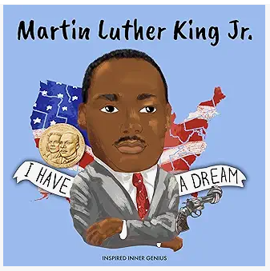
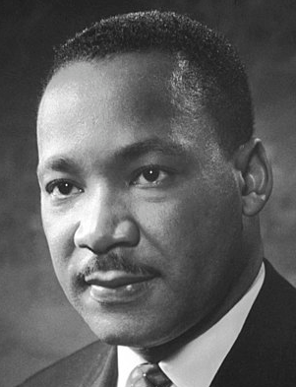
YEAR 6 RE (Autumn 2) For Christians, What Kind of King is Jesus
Vocabulary | Knowledge |  | Recommended Reads
Racial segregation – The separation of people into racial or ethnic groups in daily life. | Martin Luther King Jr was a key member of the American Civil Rights Movement during the 1950’s and 1960’s. Using non-violent protest, he campaigned for equal rights for black Americans and an end to racial segregation. His campaigning meant that the law was changed so that everyone in America had the same rights regardless of their skin colour. He was assassinated in 1968.
Peaceful protest – The practice of achieving goals, such as social changes, through non-violent protests.
Prejudice – A preconceived opinion that is not based on evidence or experience.
 |  |  | www.salvationarmy.org.uk
Sin – An act that Christian's believe is against God’s will and is therefore morally wrong. | Luke 4 (Verses 1-8) This passage from the gospels tells us how Jesus is tested in the wilderness by the devil. The devil tempts Jesus in a number of ways, he: entices Jesus to use the power of God for selfish purposes and offers him the opportunity to rule the kingdoms of the world without dying on the cross.
 |  |  | Agreed Syllabus End Points Making Sense of Beliefs •Explain connections between biblical texts and the concept of the kingdom of God • Consider different possible meanings for the biblical texts studied, showing awareness of different interpretations Understand the Impact Make clear connections between belief in the kingdom of God and how Christians put their beliefs into practice • Show how Christians put their beliefs into practice in different ways Making Connections • Relate the Christian ‘kingdom of God’ model (i.e. loving others, serving the needy) to issues, problems and opportunities in the world today • Articulate their own responses to the idea of the importance of love and service in the world today.
Salvation – The saving of a Christian believer from sin.
Analyse – The examine something, step by step and in detail
Parable – A simple story used to illustrate a moral or spiritual lesson, as told by Jesus in the gospels | The Feast – Luke 14, Verses 12-24 A parable told by Jesus telling Christians that the Kingdom of God is like a feast which everyone is invited to, but only some attend because they are distracted by the superficial pleasures of their own lives.
Gospel – The record of Christ’s life and teachings in the first four books of the New Testament. The gospels are named Matthew, Mark, Luke and John.
 | The Salvation Army – a Christian charity that puts its Christian beliefs into practice through work in the community. |  | .
The Kingdom of God – Where Christians believe God rules. Not an actual place, but in human hearts, minds, lives and communities. | The Kingdom of God Model – The idea that to be part of the Kingdom of God a person has to serve others, particularly those who are most vulnerable and in need.
“Putting into practice” Behaving or acting in a way that reflects your beliefs. |  | Martin Luther King Jr 1929 – 1968

