Slide 1

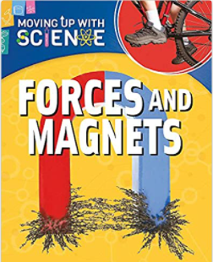
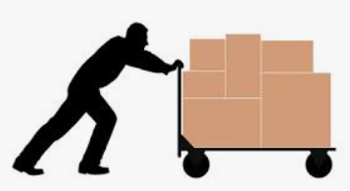
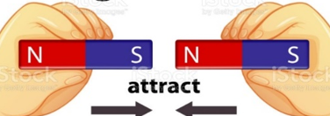
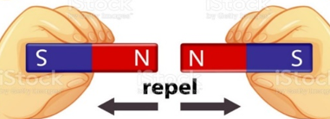
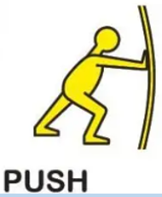

YEAR 3 SCIENCE – FORCES AND MAGNETS Autumn 1
Tier 3 Vocabulary | Knowledge Facts |  | Book Curriculum & Recommended Reads
Force – A force that is a push or a pull. | A force can be a push or pull. When force moves an object away from something, that is a push. When force brings an object closer, that is a pull.
 | Pushes and pulls can change an objects speed direction and shape. When forces are balanced the object stays still.
Friction: Friction is a force between two surfaces that are sliding, or trying to slide, across each other
 | For most forces to work, contact with the object is needed. However, magnets can move objects without touching them.
 | Heavier objects need more force to move them than lighter objects |  | National Curriculum End Points Compare how things move on different surfaces. Notice that some forces need contact between two objects, but magnetic forces can act at a distance. Observe how magnets attract or repel each other and attract some materials and not others. Compare and group together a variety of everyday materials on the basis of whether they are attracted to a magnet, and identify some magnetic materials. Describe magnets as having two poles. Predict whether two magnets will attract or repel each other, depending on which poles are facing.
Magnet – A metal that attracts certain other metals.
 | Friction slows objects down. Friction is the force between two surfaces which are sliding against each other. Smooth surfaces have less friction, rough surfaces have more friction
 | Magnets attract some metals – these metals are iron and steel. Most other metals, for example aluminium, copper and gold, are NOT magnetic
Magnetic material: A magnetic material is one that can be attracted to a magnet.
 | Magnets have two poles, North and South. When two of the same poles are placed close together they repel (push apart) each other. When two different poles are close, they attract (pull together) each other.
Repel To push apart.
Attract To pull together.
 | Magnets are not all the same strength; some can be much stronger than others

Slide 2
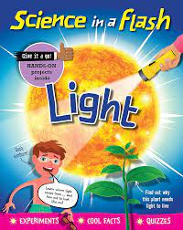

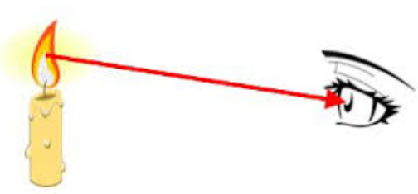
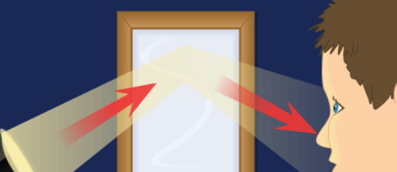
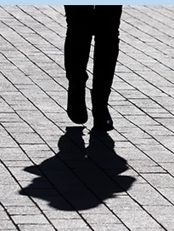
YEAR 3 SCIENCE – Light Autumn 2
Tier 3 Vocabulary |  | Knowledge Facts |  |  | Recommended Reads
Light – We need light to see. |  | We need light in order to see things and that dark is the absence of light
Dark - is when there is no light
 |  | Light from light sources travels to our eyes in straight lines..
Light Source – an object that produces light.
Luminous – an object that produces light. |  |  | Reflected light is bounced off objects and then it travels to our eyes
 |  |  |  |  | National Curriculum End Points Recognise that we need light in order to see things and that dark is the absence of light. Notice that light is reflected from surfaces. Recognise that shadows are formed when the light from a light sources is blocked by a solid object. Find patterns in the way that the size of shadows change. Recognise that light from the sun can be dangerous and that there are ways to protect their eyes.
Reflection – when light bounces off a surface. |  | Light and shiny colours and surfaces are good reflectors. More of the light is bounced back to our eyes.
Opaque – Objects that block light |  | Dark and dull colours and surfaces are poor reflectors. Only some of the light is bounced back to our eyes. The rest is absorbed by the object. |  |  | Recognise that we need light in order to see things and that dark is the absence of light. Notice that light is reflected from surfaces. Recognise that shadows are formed when the light from a light sources is blocked by a solid object. Find patterns in the way that the size of shadows change. Recognise that light from the sun can be dangerous and that there are ways to protect their eyes.
 |  | Shadows are formed when light cannot pass through an object. |  |  | Recognise that we need light in order to see things and that dark is the absence of light. Notice that light is reflected from surfaces. Recognise that shadows are formed when the light from a light sources is blocked by a solid object. Find patterns in the way that the size of shadows change. Recognise that light from the sun can be dangerous and that there are ways to protect their eyes.
Transparent - Objects that light can travel through. |  | The darkest shadows are formed by opaque objects.
Translucent – Object that some light to passes through. |  | The closer to the light source an object is, the bigger the shadow will be.
 | Shadows are formed when light cannot pass through an object | Light from the sun can be dangerous. We can protect our eyes by wearing sunglasses and a wide brimmed hat.
 |  | We must never ever look directly at the sun or other bright lights as this can damage our eyes.

Slide 3
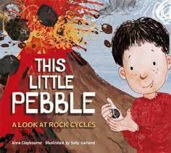


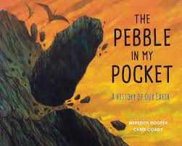
YEAR 3 SCIENCE – Rocks and Fossils – Spring 1
Tier 3 Vocabulary | Knowledge Facts | Recommended Reads
Appearance – What something looks like | There are three types of naturally occurring rocks: Sedimentary rock. Formed under the sea, by layers of sediment building up and being squashed together to make rock. Igneous rock: Formed from cooled molten rock. Can be formed both molten rock cooling underground (magma) or cooling overground (lava). Metamorphic rock: Formed underground by heat or pressure. Igneous or sedimentary rocks change into metamorphic rock because they are heated by magma or by the heat from being squeezed and pressed by earth movements.
Properties – The weight, hardness and texture of something.
Sediment – very small pieces of rock and sand that are moved by rivers, wind and glaciers (ice rivers).
Durable – Not easily broken or worn out, lasts a long time.
 | The three different types of rock have different appearances and properties. Sedimentary rock is – soft and crumbly, permeable and not durable. Igneous rock is – hard, sometimes has shiny pieces in it, it’s nonpermeable and very durable. Metamorphic rock is – hard, nonpermeable and very durable.
Permeable – Liquids, like water, can pass through it.
Question – What do we want to find out?
Prediction – What do we think will happen? | Soil is a mixture of tiny particles of dead and rotting plants and animals, rock, air and water. Soil also contains minerals from the small pieces of rock that are in it.
Conclusion – What happened and what does this tell me.
Particle – A tiny part of something | Fossils are formed in the following way 1- The animal died 2 – It was quickly buried by an event like a landslide. 3 – The soft parts of the body rotted away leaving the skeleton. 4 – Layers of sediment build up on top of the skeleton and over the years they pressed down and turn the sediment into rock. 5 – The animal skeleton dissolves, leaving a gap the same shape as the animal, Minerals fill this gap and a rock copy of the animals bones is formed. 6 – Over millions of years the earths plates move around. Rocks that were at the the bottom of the ocean move to the surface. 7 – Over time the rock layers are worn away and the fossil is revealed. | National Curriculum Objectives Compare and group together different kinds of rocks on the basis of their appearance and simple physical properties. Describe in simple terms how fossils are formed when things that have lived are trapped in rock. Recognise that soils are made from rocks and organic matter.
Humus – Decaying pieces of plants and animals.
Soil - Soil is the layer that covers the land. It is also called earth and sometimes dirt
Fossils are the preserved remains of animals and plants that lived a long time ago | Fossils are formed in the following way 1- The animal died 2 – It was quickly buried by an event like a landslide. 3 – The soft parts of the body rotted away leaving the skeleton. 4 – Layers of sediment build up on top of the skeleton and over the years they pressed down and turn the sediment into rock. 5 – The animal skeleton dissolves, leaving a gap the same shape as the animal, Minerals fill this gap and a rock copy of the animals bones is formed. 6 – Over millions of years the earths plates move around. Rocks that were at the the bottom of the ocean move to the surface. 7 – Over time the rock layers are worn away and the fossil is revealed. | National Curriculum Objectives Compare and group together different kinds of rocks on the basis of their appearance and simple physical properties. Describe in simple terms how fossils are formed when things that have lived are trapped in rock. Recognise that soils are made from rocks and organic matter.
Trace fossils – The footprints, poo and nests of animals that lived a long time ago,

Slide 4
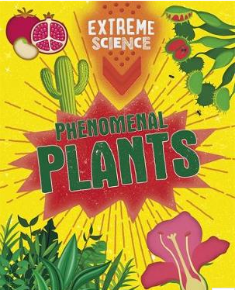


YEAR 3 SCIENCE – Plants – Spring 2
Tier 3 Vocabulary | Knowledge Facts |  | Recommended Reads
Carbon Dioxide – A gas that is found in the air. | The functions of each part of a flowering plant. Roots secure the plant in the ground and absorb water from the soil. Roots also absorb nutrients from the soil so the plant can thrive. Stem / trunk - The stem or trunk supports the branches and leaves along with fruit and flowers and transports nutrients and water around the plant. Leaves - The leaves make food from sunlight and carbon dioxide Flowers - Flowers attract insects and birds, helping the plant to reproduce.
Nutrients – Nutrients help plants to grow well, they are found in soil.
Reproduction - The making of an offspring. Babies are human offspring.
Adapted – The plant has made changes to what it needs, so it can survive in different places. | Plants need the following to grow well: Air, Light, Water, Nutrients from the soil | Room to grow. These elements vary from plant to plant as some plants have adapted to their environment.
 |  |  | National Curriculum Objectives Identify and describe the functions of different parts of flowering plants: roots, stem/trunk, leaves and flowers. Explore the requirements of plants for life and growth (air, light, water, nutrients from soil, & room to grow) & how they vary from plant to plant. Investigate the way in which water is transported within plants. Explore the part that flowers play in the life cycle of a flowering plant, including pollinations, seed formation and seed dispersal.
Xylem: the tubes in plants which move water and nutrients upwards from the root
Pollen: Pollen is a fine powder produced by a flower’s anthers. It is needed to fertilise plants so they can make seeds and new plants can grow.
 | Water Transportation The roots absorb water from the soil. The stem transports water to the leaves. Water evaporates from the leaves. This evaporation causes more water to be sucked up the stem. The water is sucked up the stem like water being sucked up through a straw. These straw like stubes are called xylem
Seedling: a young plant
Anthers – The male part of a flower which produces pollen | The part flowers play in the plant life cycle Flowers have bright colours, smells and nectar which attracts and encourage bees and other insects. Insects brush against the pollen on the anthers and move it to the stigma. Insects also carry pollen from other flowers. The plant can now produce seeds. Seed dispersal Seeds are scattered by the wind, water, animals, animals eating fruit and seed explosions.
Stigma – The female part of a flower.

Slide 5
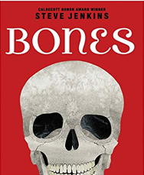
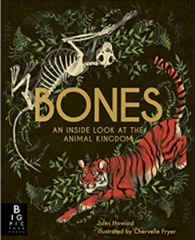

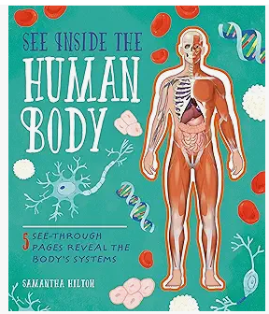
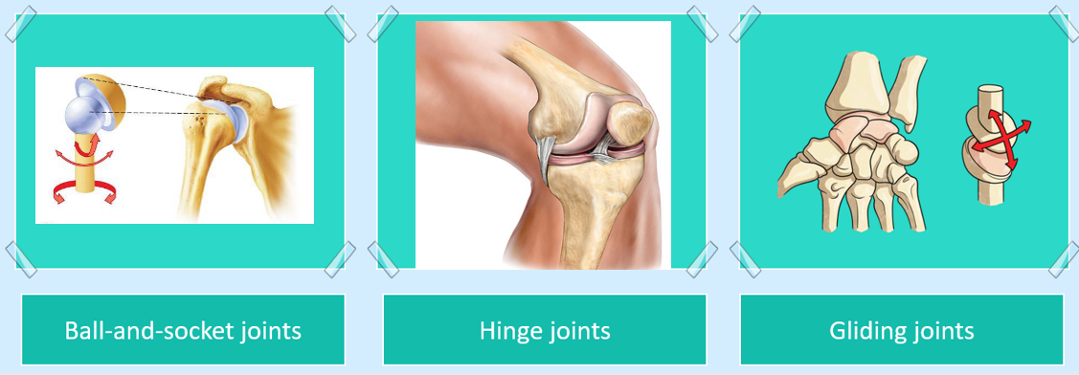
YEAR 3 SCIENCE – ANIMALS, INCLUDING HUMANS: SKELETONS & MUSCLES – Summer 1
Tier 3 Vocabulary | Knowledge Facts | Recommended Reads
Vertebrate An animal with an internal skeleton. e.g. a dog, cat or human | Skeletons have 3 functions: to protect organs, hold the body upright, give the body structure and shape, and allow the body to move.
Invertebrate An animal without an internal skeleton e.g. a worm, jellyfish or beetle. | A skeleton is made from bone, joints and cartilage.
Exoskeleton An external skeleton that protects an animal's soft body e.g a snail, lobster or spider. | There are 3 types of joint, hinge joints, ball joints and glide joints
Bones Bones make up most of a skeleton. They are living tissue and are light and very strong. | Some muscles work without us thinking, like our heart beating, while other muscles are controlled by our thoughts and allow us move around.
Joint A joint is where two bones meet and movement occurs e.g. elbow, knee, shoulder, wrist
 | Muscles work in pairs to move limbs. The biceps contract while the triceps relax to bend the arm. They then work in the opposite way to straighten it again. | National Curriculum End Points Identify that humans and some animals have skeletons and muscles for support, protection and movement.
Cartilage protects our joints and bones from rubbing against one another.
Muscle Muscles are made of strong stretchy tissue that can contract and relax to make our bones move.
Relax: When a muscle relaxes, it allows itself to lengthen and go back to its original position.
Contract: If a muscle contracts, it gets shorter.

Slide 6
ARCHIVE

Slide 7
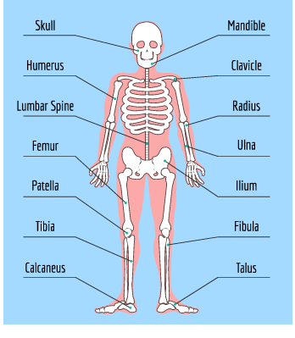
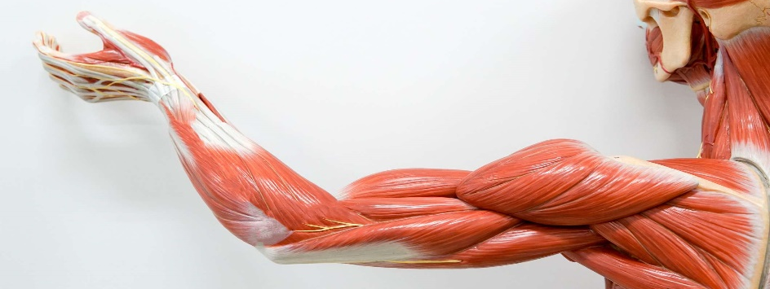
YEAR 3 SCIENCE – ANIMALS, INCLUDING HUMANS: SKELETONS & MUSCLES DON’T USE BEING REVIEWED
Tier 3 Vocabulary | Knowledge Facts | Recommended Reads
Vertebrate: An animal with a spine e.g. a dog, cat or human | Plants obtain their food from their environment, animals obtain their food from what they eat.
 | Animals with a skeleton inside their body are called vertebrates, animals without a backbone are called invertebrates.
Invertebrate: An animal without a spine e.g. a worm, jellyfish or beetle.
 | A skeleton’s function is to protect, support and allow the body to move.
 | An adult human has 206 bones in their skeleton. | The Human Skeletal System
Skeleton: A rigid structure that supports and protects the body, and allows it to move
 | Some muscles work without us thinking, like our heart beating, while other muscles are controlled by our thoughts and allow us to do stuff and move around.
 | Muscles work in pairs to move your arm, the biceps contract while the triceps relax to bend the arm. They then work in the opposite way to straighten it again.
Contract: To contract is to shorten – the bicep shortens to bend the elbow.
 | National Curriculum End Points Identify that humans and some animals have skeletons and muscles for support, protection and movement.
Relax: When a muscle relaxes, it allows itself to lengthen and go back to its original position.
Joint: A joint is where two bones meet and movement occurs e.g. elbow, knee, shoulder, wrist

