Slide 1

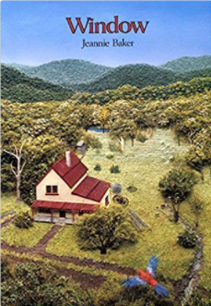

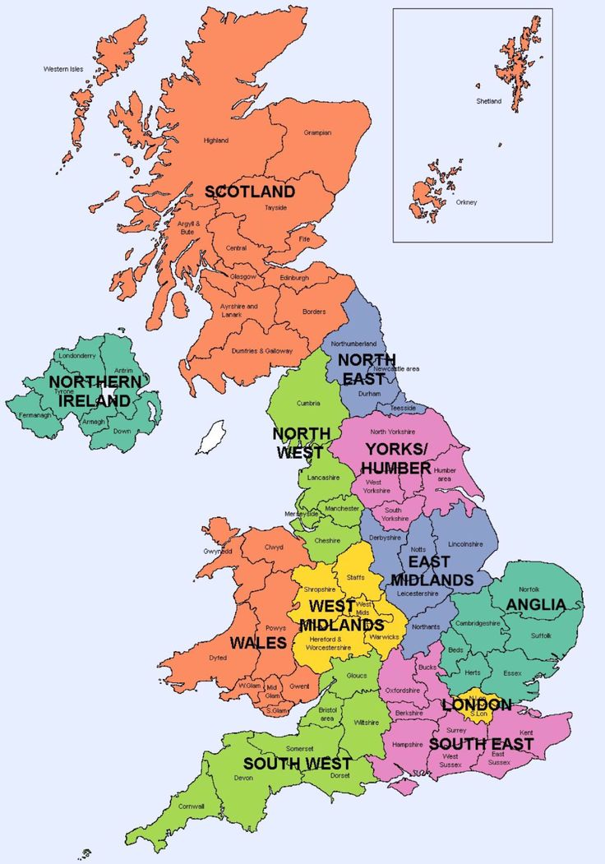
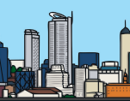
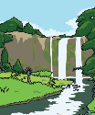
YEAR 3 GEOGRAPHY – HOW HAS OUR LOCAL AREA CHANGED?
Tier 3 Vocabulary | Knowledge Facts | Recommended Reads
Human feature: Human features are things like houses, roads and bridges that have been built by people. | Glenriding is a small, rural village in Cumbria. Storm Desmond hit in 2015 and flooded the settlement.
 | The Olympic park used to be a very deprived, industrial area before being turned into a modern sporting park.
Physical feature: Physical features, like seas, mountains and rivers, are natural. They would be here even if there were no people around.
 | Lanner school has changed a lot over the past 20 years, including being reroofed 3 times and new fencing around the grounds.
Continent: Any of the world's main continuous expanses of land (Europe, Asia, Africa, North and South America, Australia, Antarctica).
 | Lanner school used to be in a different place in the village. | Geographical Regions of the UK
 | London is the capital of England, Scotland and Wales are linked by land but are actually different countries.
Country: A nation with its own government, occupying a particular territory
 | Northern Ireland and Ireland are different countries, but are one island.
County: Countries are divided up in counties, which have their own councils that run and make decisions for the county. E.g. Cornwall, Devon, Somerset | National Curriculum End Points Locate the world’s countries, using maps to focus on Europe (including the location of Russia) & North and South America. Name and locate counties and cities of the United Kingdom, geographical regions and their identifying human and physical characteristics, key topographical features (including hills, mountains, coasts and rivers) and land-use patterns; and understand how some of these aspects have changed over time.
Geographical Region: The UK is split into several regions e.g. South West, West Midlands, East Midlands ec. These regions are made up of several counties in the same area. | . human features physical features
Topographical feature: Topography describes the physical features of an area of land. These features typically include natural formations such as mountains, rivers, lakes, and valleys

Slide 2

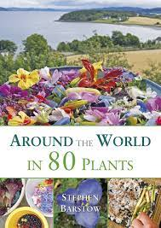
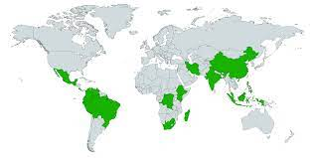
YEAR 3 GEOGRAPHY- Plants of the world Spring 2
Tier 3 Vocabulary | Knowledge Facts | Recommended Reads
Botanist: An expert in or student of the scientific study of plants. | Plants are found all over the world, in the Northern and Southern hemispheres. They even grow in the North and South Pole.
Species: A group of plants or animals that are the same type.
 | Plants and animals are all suited to different climates. A climate zone and the plants and animals that live within it make up a biome.
Hemisphere: A half of the earth, usually as divided into northern and southern halves by the equator.
 | Desert biomes are most difficult for plants to survive in because they have extreme climates. Deserts can be both hot and cold.
Flora: Plant life.
Fauna: Animal life.
Biome: A large naturally occurring community of flora and fauna occupying a major habitat, e.g. forest or tundra. | The business of producing food, whether you are producing food for yourself or to sell to other people, is called agriculture. Agriculture includes rearing animals for meat and dairy products, as well as growing plant crops.
Climate zone: Climate zones are areas with distinct climates, which occur in east-west direction around the Earth. | Humans use plants for many purposes: wood, paper, medicine, fabrics, cosmetics and rubber.
 | A mega-diverse country is one of a group of countries that house the majority of the world’s species of plants and animals. There are seventeen mega-diverse countries in the world with we can find using a four-figure grid reference.
Adaption: Adaptations are special features that allow a plant or animal to live in a particular place or habitat. These adaptations might make it very difficult for the plant to survive in a different place.
 | National Curriculum End Points Describe and understand key aspects of physical geography including: climate zones, biomes and vegetation belts. Use maps, atlases, globes and digital / computer mapping to locate countries and describe features studied. Use four-figure grid references, symbols and key (including the use of Ordnance Survey maps) to build their knowledge of the United Kingdom and the wider world.
Agriculture: Agriculture is the practice of cultivating plants and livestock – farming.
Biodiversity: Biodiversity is all the different kinds of life you'll find in one area—the variety of animals, plants, fungi, and even microorganisms.
Mega-diversity: There is extreme high biodiversity.

Slide 3
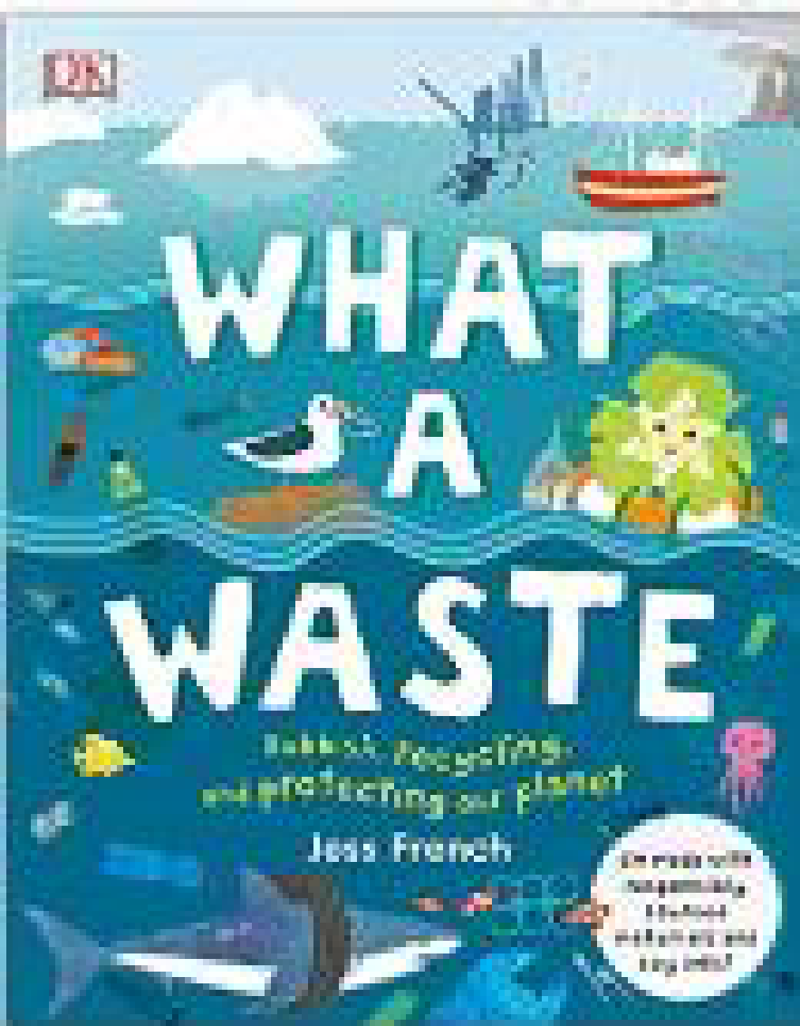
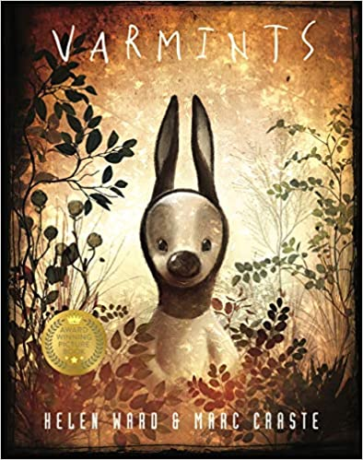
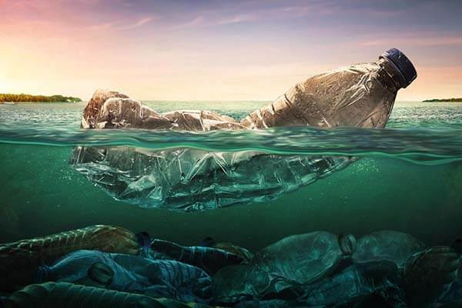
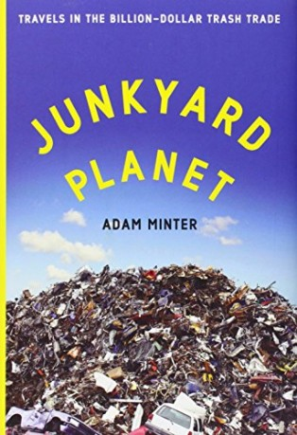
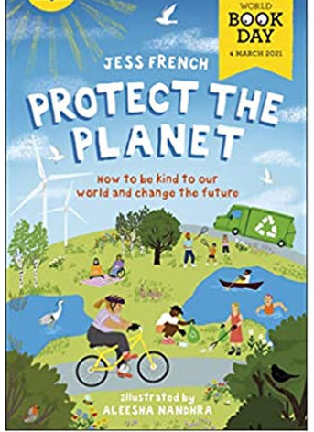
YEAR 3 GEOGRAPHY – What a Waste – Summer 1
Tier 3 Vocabulary | Knowledge Facts | Recommended Reads
Sustainable: sustainability means meeting our own needs without compromising the ability of future generations to meet their own needs | The Isles of Scilly are an archipelago 28 miles off Cornwall. Being sustainable is taking care to only use what you need from the earth.
 | Our school can do lots of things to be more sustainable. This could include having recycling bins in the playground, having automatic light switches or a compost heap.
Renewable: a natural resource or source of energy that is not depleted by use, such as water, wind, or solar power.
 | Conserving water saves energy. Energy is needed to filter, heat and pump water to your home, so reducing your water use also reduces your carbon footprint.
Finite/infinite: Finite is to be limited in size or extent, infinite is limitless or endless in space, extent, or size; impossible to measure or calculate
 | Solar and wind farms are becoming more common in Cornwall as they are sources of renewable energy, cutting out emissions and pollution in the environment.
Biodiversity: the variety of plant and animal life in the world or in a particular habitat, a high level of which is usually considered to be important and desirable
 | Most natural resources are not distributed evenly around the Earth. For example, some areas have abundant water, whereas other places may be arid or prone to drought. Countries that are richly endowed with natural resources have an economic advantage because they can sell those resources to other countries.
Plastic pollution: accumulation in the environment of synthetic plastic products to the point that they create problems for wildlife and their habitats as well as for human populations
 | Did you know that every year 8 million tonnes of plastic end up in our planet’s beautiful blue oceans? And that’s seriously bad news for our friends beneath the waves… Over 700 species of marine animals have been reported to have eaten or been entangled in plastic – and scientists think that the amount of plastic in the ocean may triple by 2050
Nurdle: a very small pellet of plastic which serves as raw material in the manufacture of plastic products
Natural resources: materials or substances occurring in nature which can be exploited for economic gain; wood, oil, gas, water, gold etc | National Curriculum End Points Use maps, atlases, globes and digital / computer mapping to locate countries and describe features studied. Use the eight points of a compass, four-figure grid references, symbols and key (including the use of Ordnance Survey maps) to build their knowledge of the United Kingdom and the wider world. Use fieldwork to observe, measure and record the human and physical features in the local area using a range of methods, including sketch maps, plans and graphs, and digital technologies.
Fossil fuels : a natural fuel such as coal or gas, formed in the geological past from the remains of living organisms.

