Slide 1
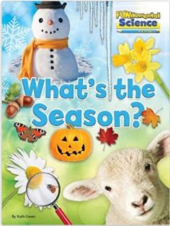
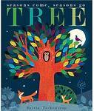
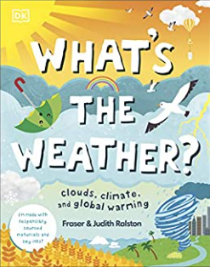
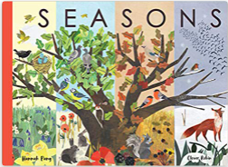
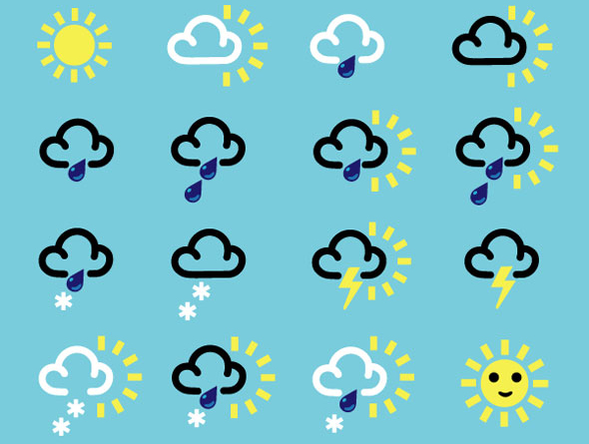
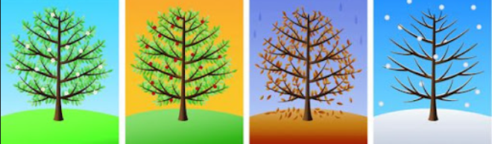
YEAR 1 SCIENCE – SEASONAL CHANGES (AUTUMN & WINTER) – Autumn 2
Tier 3 Vocabulary | Knowledge Facts | Book Curriculum & Recommended Reads
Seasons - This cycle of weather changes is divided into four parts, known as the seasons. The four seasons are winter, spring, summer, and autumn. | There are four seasons. There are 12 months. Each season lasts about 3 months. | .
 | The weather is colder in Autumn. We get more rain and wind. The leaves begin to fall off trees.
 | The seasons are defined as spring (March, April, May), summer (June, July, August), autumn (September, October, November) and winter (December, January, February). Spring and Summer get more daylight.
Months - each of the twelve named periods into which a year is divided.
Weather - Weather is sunshine, rain, snow, wind, and storms. It's what is going on outside right now.
 | A flowering plant has roots, leaves, a stem, and a flower. Most plants have roots.
 | A tree is a plant because it has roots and needs water and sunlight to grown. A tree has roots, a trunk, branches and leaves.
Changes - to make or become different
 | Not every tree loses their leaves in winter. Evergreen trees (cedar, holly) keep their leaves. Deciduous trees (ash, oak, birch) lose their leaves by winter.
Growth - an increase in size.
Structure - something built or arranged in a definite way. | National Curriculum End Points I can observe changes that occur across the four seasons. I can observe and describe weather associated with the seasons and how the day length varies. I can identify and describe the basic structure of a variety of common flowering plants, including trees. I can identify and name a variety of common wild and garden plants, including deciduous and evergreen trees.
 |  | What is the weather like today?
Vary - to change; to make different.
Plants - living things that grow from the soil and turn light from the sun into food.
 | The Seasons
Spring Summer Autumn Winter

