Slide 1


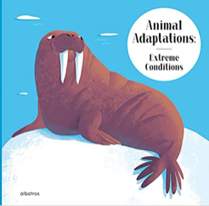


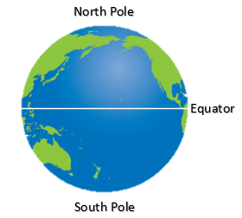
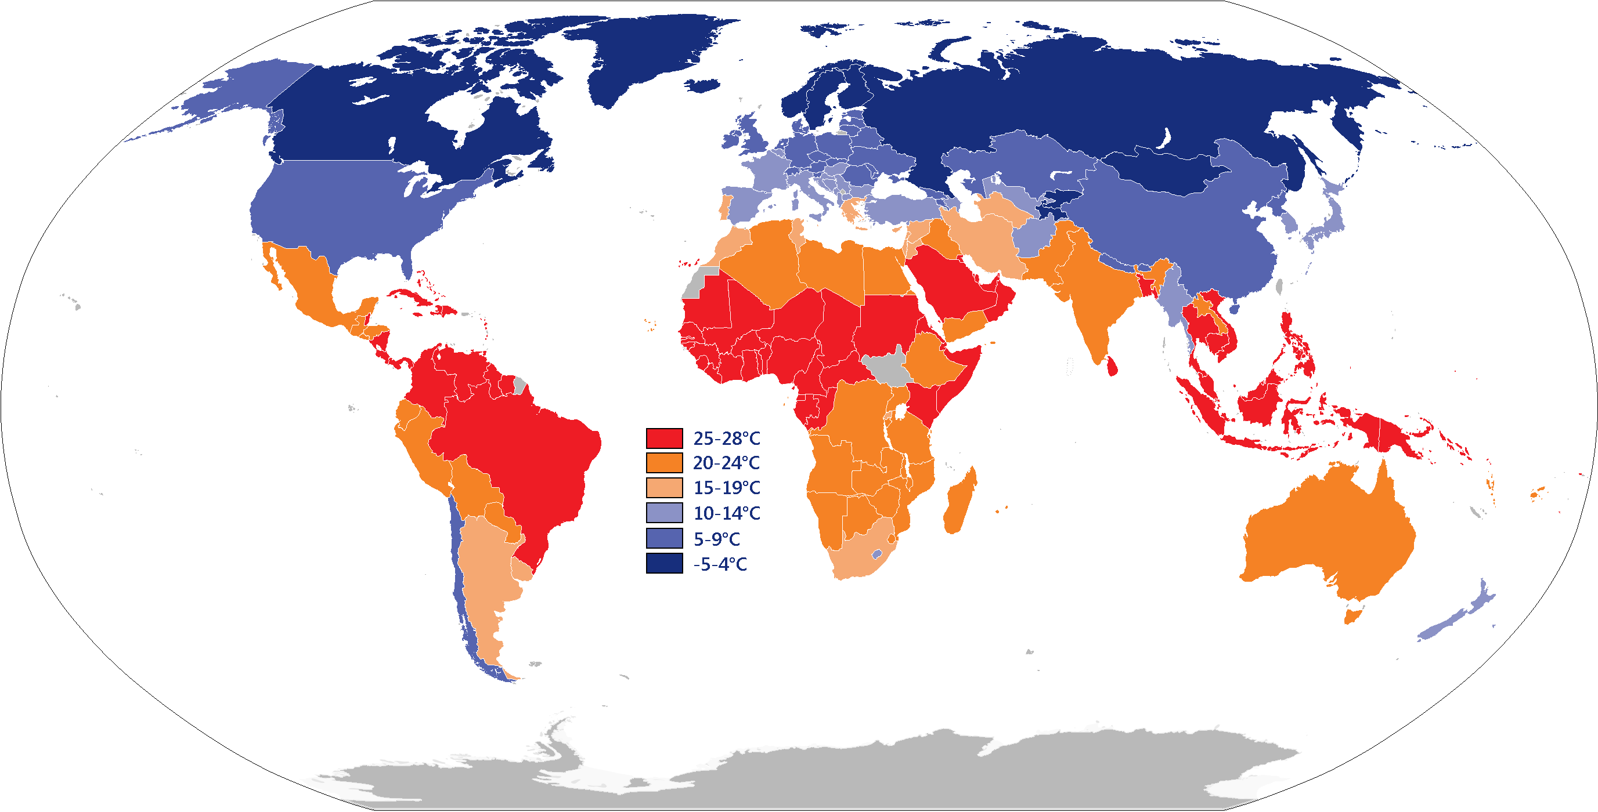
YEAR 1 GEOGRAPHY – HOT AND COLD PLACES
Tier 3 Vocabulary | Knowledge Facts | Book Curriculum
Sea - Seas are smaller than oceans and are usually located where the land and ocean meet. | The world is made up of land, sea and ice.
 | The North Pole is at the top of the world. The South Pole is at the bottom of the world. The equator is the invisible line around the middle of the world.
Land - the solid part of the earth's surface.
 | The weather is different because the poles are cold and the equator is hot.
Ice - frozen water.
 | The weather in the poles are cold and you need to wear warmer clothing. The weather near the equator is hot and you can wear lighter clothing. | Other recommended reads
Earth – Earth is one of the eight planets that orbit, or travel around, the Sun in the solar system. | The similarities in environments for Antartica and the Sahara desert include; sunlight, they are both deserts. The differences in environments: Antartica – cold, ice, water. Sahara desert – hot, sand, sand dunes
Equator - An equator is an imaginary line around the middle of a planet.
 | National Curriculum End Points I can identify the North Pole, South Pole and Equator on a map/globe. I can understand that the Poles are cold areas of the world and that the Equator is hot.
North Pole - The North Pole is the point that is farthest north on the planet Earth.
South Pole - the most southern point of the earth.
Hot – having a high degree of heat or a high temperature.
Cold - a condition of low temperature

