Slide 1
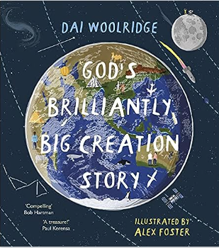
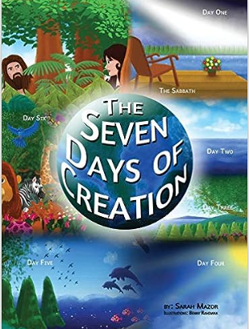
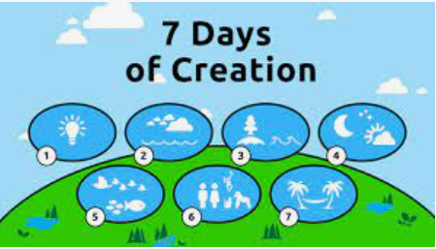
YEAR 3 RE – Autumn 1 What do Christians learn from the Creation story?
Tier 3 Vocabulary | Knowledge | Recommended Reads
Christians – people who believe in God and Jesus and are part of the Christian religion. | Christians and Jews believe that God made the Earth and all living things in it. The Creation story is the start of the ‘Big Story’ of the Bible.
Natural World – all the plants, creatures, land and water that are not made by people. | Christians and Jews share the same belief in the Creation story – that the world was created in 6 days by God and on the 7th day He rested. Christians believe that the Creation story gives messages about God: as the Creator, He is all-powerful as he made the world and he cares for everything in the world, including humans.
Creation Story – a story of how the world came into existence.
Creator – someone who has made something; Christians believe God is the Creator of the world. | Christians believe that Adam and Eve committed sin against God when they disobeyed His rules. This led to ‘the fall’ – the idea that they ‘fell away from being close to God’. Christians believe humans commit sin but God can forgive. Christians might pray to God for forgiveness. | Agreed Syllabus Learning Outcomes Make sense of belief: Place the concepts of God and Creation on a timeline of the Bible’s ‘big story’. Make clear links between Genesis 1 and what Christians believe about God and Creation. Recognise that the story of ‘the Fall’ in Genesis 3 gives an explanation of why things go wrong in the world. Understand the impact: Describe what Christians do because they believe God is Creator (e.g. follow God, wonder at how amazing God’s creation is, care for the Earth). Describe how and why Christians might pray to God, say sorry and ask for forgiveness. Make connections: Ask questions and suggest answers about what might be important in the Creation story for Christians and for non-Christians living today.
Genesis – the first book of the Bible, which tells the Christian and Jewish story of Creation.
Sin – behaviour that goes against the laws or rules of God. | The Bible is important to Christians as a guide to life, helping them to decide how to live their lives. | Agreed Syllabus Learning Outcomes Make sense of belief: Place the concepts of God and Creation on a timeline of the Bible’s ‘big story’. Make clear links between Genesis 1 and what Christians believe about God and Creation. Recognise that the story of ‘the Fall’ in Genesis 3 gives an explanation of why things go wrong in the world. Understand the impact: Describe what Christians do because they believe God is Creator (e.g. follow God, wonder at how amazing God’s creation is, care for the Earth). Describe how and why Christians might pray to God, say sorry and ask for forgiveness. Make connections: Ask questions and suggest answers about what might be important in the Creation story for Christians and for non-Christians living today.
Garden of Eden - a beautiful garden where Christians believe Adam and Eve were placed at the Creation. | Christians believe that they should do their best to care for the world that God created and owns. You don’t have to be Christian to look after the Earth.
Adam and Eve – Christians believe they were the first people, created by God.
Forgiveness – a choice to stop being upset or angry with someone who has done something wrong.
Bible – the special book in the Christian religion.
Conservation – the protection of things found in the natural world. | Many Hindus believe that the soul passes through a series of lives with the next lives always being dependent on how the previous ones were lived. Hindus believe that eventually, if someone truly understands atman, does their duty (dharma) and lives a good life (karma), they will achieve moksha, which means release from samsara (the cycle of life, death and rebirth). They will not have to be born again and their atman is released to merge back into Brahman. | Agreed Syllabus End Points Understand the impact: •

Slide 2
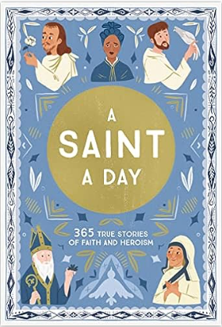
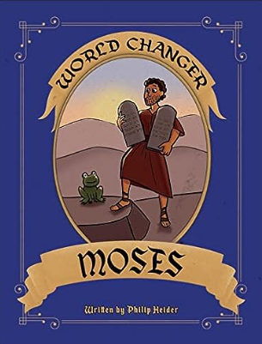
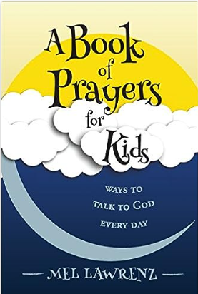
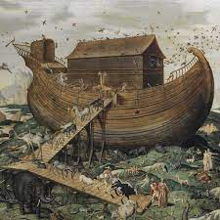
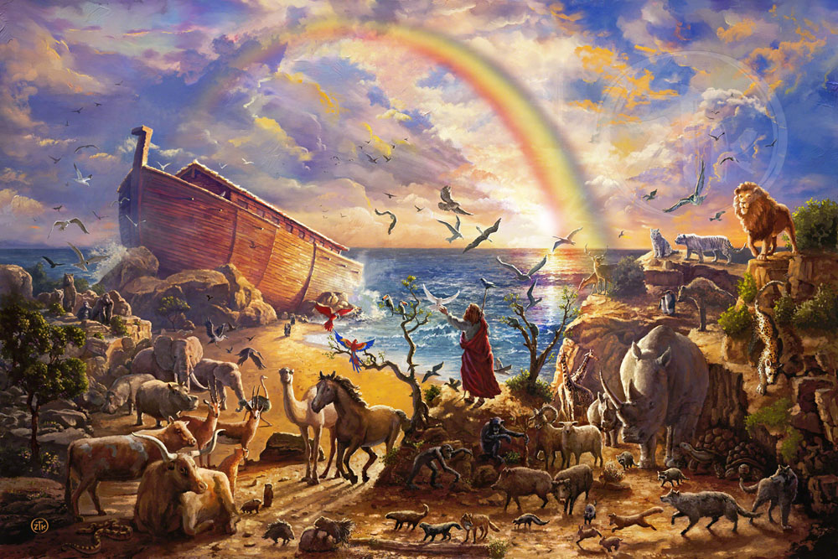
YEAR 3 RE – Autumn 2 What is it like for someone to follow God?
Tier 3 Vocabulary | Knowledge | Recommended Reads
Chapters- The several books of the Old and New Testaments were from an early time divided into chapters. | The People of God try to live in the way God wants, following his commands and worshipping him.
Verses- The common system divides each biblical book into chapters and further divides each chapter into verses. | Christians believe that he promises to stay with them, and Bible stories show how God keeps his promises.
 | The Old Testament tells the story of a particular group of people, the children of Israel, known as the People of God, and their relationship with God.
Pacts- a formal agreement between individuals or parties.
Promises- assure someone that one will definitely do something or that something will happen. | Christians believe that Noah was trying to do away with evil in the world and make it a better place. | Agreed Syllabus Learning Outcomes Make sense of belief: Make clear links between the story of Noah and the idea of the covenant. Understand the Impact: Make simple links between promises in the story of Noah and promises that Christians make at a wedding ceremony. Make connections: Make links between the story of Noah and how we live in school and the wider world.
 | Christians believe that Noah was told by God to build a boat named the Ark.
Symbols-a thing that represents or stands for something else, |  | Agreed Syllabus End Points Make sense of belief: • Identify some Jewish beliefs about God, sin and forgiveness and describewhat they mean. • Make clear links between the story of the Exodus and Jewish beliefs about God and his relationship with the Jewish people • Offer informed suggestions about the meaning of the Exodus story for Jews today. Understand the impact: • Make simple links between Jewish beliefs about God and his people and how Jews live (e.g. through celebrating forgiveness, salvation and freedom at festivals) • Describe how Jews show their beliefs through worship in festivals, both at home and in wider communities Make connections: • Raise questions and suggest answers about whether it is good for Jewsand everyone else to remember the past and look forward to the future. • Make links with the value of personal reflection, saying sorry, beingforgiven, being grateful, seeking freedom and justice in the world today,including pupils’ own lives, and giving good reasons for their ideas
Forgiveness-– a choice to stop being upset or angry with someone who has done something wrong. | Christians believe that Noah was one of the people of God trying to follow his commands.
Command- Being told to do something.
Covenant- Promises made by two people to each other. | Many Hindus believe that the soul passes through a series of lives with the next lives always being dependent on how the previous ones were lived. Hindus believe that eventually, if someone truly understands atman, does their duty (dharma) and lives a good life (karma), they will achieve moksha, which means release from samsara (the cycle of life, death and rebirth). They will not have to be born again and their atman is released to merge back into Brahman. | Agreed Syllabus End Points Understand the impact: •

Slide 3
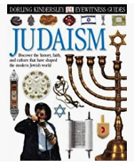
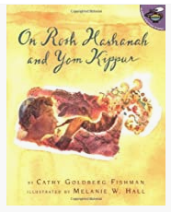
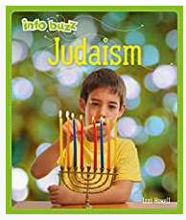
YEAR 3 RE - Spring 1 How do Festivals and Family Life show what matters to Jewish people?
Tier 3 Vocabulary | Knowledge | Recommended Reads
Shabbat - Shabbat is the Hebrew word for Sabbath, which Jewish people mark from nightfall on Friday night until nightfall on Saturday | Shabbat is so special that for Jewish people that it is like a religious holiday each week. Many Jewish people prepare for the arrival of Shabbat carefully – as you would expect someone to prepare if a Queen was coming. Jewish People set out their table with– wine, candles, two loaves of challah bread. During Shabbat, Jewish people are not permitted to complete activities that are considered ‘work’ such as cleaning or homework.
Torah - Torah constitutes the first five books of the Hebrew Bible
Challah- a type of leavened egg bread, traditionally eaten by Jewish people on the Sabbath and religious holidays.
 | Rosh Hashanah is the Jewish new year. Jewish people examine their deeds from the past year and look to make a fresh start for the next year. Rosh Hashanah takes place on the 18th September and the festival lasts for two days. One Rosh Hashanah tradition involves blowing a large horn called a Shofar. | Agreed Syllabus Learning Outcomes Make sense of belief: • Identify some Jewish beliefs about God, sin and forgiveness and describe what they mean. • Make clear links between the story of the Exodus and Jewish beliefs about God and his relationship with the Jewish people • Offer informed suggestions about the meaning of the Exodus story for Jews today. Understand the impact: • Make simple links between Jewish beliefs about God and his people and how Jewish people live (e.g. through celebrating forgiveness, salvation and freedom at festivals) • Describe how Jewish people show their beliefs through worship in festivals, both at home and in wider communities Make connections: • Raise questions and suggest answers about whether it is good for Jewish people and everyone else to remember the past and look forward to the future. • Make links with the value of personal reflection, saying sorry, being forgiven, being grateful, seeking freedom and justice in the world today ,including pupils’ own lives, and giving good reasons for their ideas
Synagogue- a place used by Jewish people for worship and religious instruction.
Kosher- food prepared according to Jewish laws of food. |  | Agreed Syllabus End Points Make sense of belief: • Identify some Jewish beliefs about God, sin and forgiveness and describewhat they mean. • Make clear links between the story of the Exodus and Jewish beliefs about God and his relationship with the Jewish people • Offer informed suggestions about the meaning of the Exodus story for Jews today. Understand the impact: • Make simple links between Jewish beliefs about God and his people and how Jews live (e.g. through celebrating forgiveness, salvation and freedom at festivals) • Describe how Jews show their beliefs through worship in festivals, both at home and in wider communities Make connections: • Raise questions and suggest answers about whether it is good for Jewsand everyone else to remember the past and look forward to the future. • Make links with the value of personal reflection, saying sorry, beingforgiven, being grateful, seeking freedom and justice in the world today,including pupils’ own lives, and giving good reasons for their ideas
Rosh Hashanah- a high holy day that celebrates the beginning of the New Year according to the Jewish calendar. | Yom Kippur is the holiest day in Judaism. It is a day marked by prayer and fasting. Yom Kippur is observed on the 10th day of the Jewish calendar month Tishri. The holiday usually occurs in September or October. The holiday’s purpose is to purify the individual and community. On Yom Kippur Jewish people are forgiven for their sins against God. They also ask for forgiveness from people they have wronged.
Yom Kippur- the holiest day in the Jewish religion, observed by praying, not eating, and asking forgiveness for sins. | Known as Pesach in Hebrew, Passover is an important Jewish holiday which is a day of remembrance for when Moses led Jewish slaves out of Egypt. Passover takes place during the spring, on the 15th day of the Hebrew month, Nisan. During the seven-day celebration, a service, known as Seder, takes place. Jewish families will gather and enjoy a special meal, called the Seder meal. This includes specific types of foods and drink such as matzot, unleavened bread that forms an important part of the Seder plate.
Pesach- Passover, also called Pesach, is a major Jewish holiday that celebrates the Biblical story of the Israelites escape from slavery in Egypt. | Many Hindus believe that the soul passes through a series of lives with the next lives always being dependent on how the previous ones were lived. Hindus believe that eventually, if someone truly understands atman, does their duty (dharma) and lives a good life (karma), they will achieve moksha, which means release from samsara (the cycle of life, death and rebirth). They will not have to be born again and their atman is released to merge back into Brahman. | Agreed Syllabus End Points Understand the impact: •

Slide 4

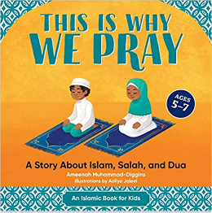
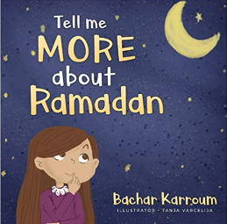
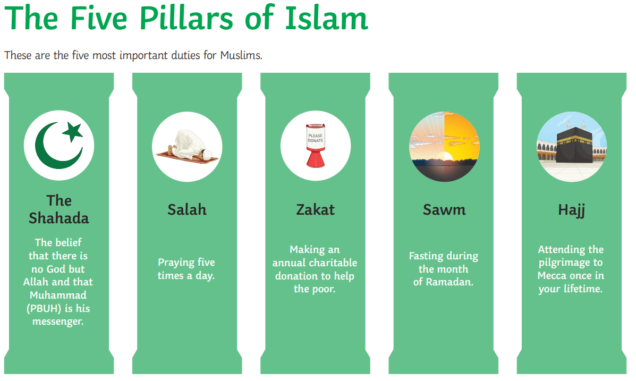
YEAR 3 RE - Spring 2 How do Festivals and Worship show what matters to Muslim people?
Tier 3 Vocabulary | Knowledge | Recommended Reads
Qur’an- The Qur’an is the Islamic Holy book. | Muslims believe the Qur'an is the direct word of Allah. Allah is the Arabic word for God.
Worship- to love, respect, and admire someone or something very much.
Prophets- a person regarded as an inspired teacher or proclaimer of the will of God. | Salah is the second of the Five Pillars of Islam . It is the belief that Muslims should pray five times each day. | Agreed Syllabus Learning Outcomes Make sense of belief: Identify some beliefs about God in Islam, expressed in Surah1. Make clear links between beliefs about God and ibadah (e.g. how God is worth worshipping; how Muslims submit to God). Understand the impact: Give examples of ibadah (worship) in Islam (e.g. prayer, fasting, celebrating) and describe what they involve. Make links between Muslim beliefs about God and a range of ways in which Muslims worship (e.g. in prayer and fasting, as a family and as a community, at home and in the mosque). Make connections: Raise questions and suggest answers about the value of submission and self-control to Muslims, and whether there are benefits for people who are not Muslims. Make links between the Muslim idea of living in harmony with the Creator and the need for all people to live in harmony with each other in the world today, giving good reasons for their ideas.
Mosque- a Muslim place of worship
Prayer- the act or practice of praying to God or a god |  | Agreed Syllabus End Points Make sense of belief: • Identify some Jewish beliefs about God, sin and forgiveness and describewhat they mean. • Make clear links between the story of the Exodus and Jewish beliefs about God and his relationship with the Jewish people • Offer informed suggestions about the meaning of the Exodus story for Jews today. Understand the impact: • Make simple links between Jewish beliefs about God and his people and how Jews live (e.g. through celebrating forgiveness, salvation and freedom at festivals) • Describe how Jews show their beliefs through worship in festivals, both at home and in wider communities Make connections: • Raise questions and suggest answers about whether it is good for Jewsand everyone else to remember the past and look forward to the future. • Make links with the value of personal reflection, saying sorry, beingforgiven, being grateful, seeking freedom and justice in the world today,including pupils’ own lives, and giving good reasons for their ideas
Ramadan- a holy month of worship. | The Qur’an is kept on a high shelf above other books, and the boys wash before handling it, to show their respect for the word of God, or Allah.
Allah- Allah is the Arabic word for God. | Ramadan is based on the lunar calendar and begins with hilal, which is the Arabic word for crescent or “new moon”. This happens in the ninth month of each lunar year.
Mecca- a city in Saudi Arabia that Muslims believe was the birthplace of Muhammad and is the holiest city of Islam. | Many Hindus believe that the soul passes through a series of lives with the next lives always being dependent on how the previous ones were lived. Hindus believe that eventually, if someone truly understands atman, does their duty (dharma) and lives a good life (karma), they will achieve moksha, which means release from samsara (the cycle of life, death and rebirth). They will not have to be born again and their atman is released to merge back into Brahman. | Agreed Syllabus End Points Understand the impact: •

Slide 5
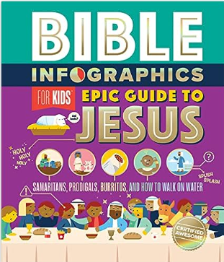
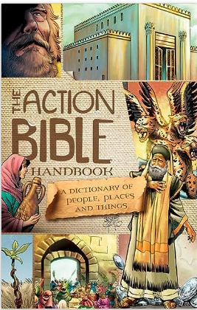
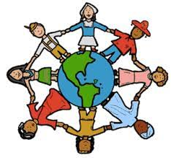
YEAR 3 RE – Summer 1 What kind of world did Jesus want?
Tier 3 Vocabulary | Knowledge | Recommended Reads
Disciples- the word disciple means follower or learner. | Many Christians believed that Jesus wanted Peter and Andrew to help him teach people about God's love for them.
Gospel- It is the news about who Jesus Christ is, what He has done, and how that changes everything.
 | Many Christians believe that the disciples helped Jesus to teach about love, forgiveness, and God’s will for us. They travelled with Jesus and witnessed him healing people. They became his closest friends.
Qualities- Qualities are personal characteristics that individual people have.
Churches- A. church is a public place of worship, usually for people of the Christian religion.
 | As a fisherman, casting his net out into the water, Jesus was asking them to cast the gospel message out to people and try to catch people’s hearts.
Fisher of people- a practical action Jesus wanted his disciples to help him do. | Christians believe Jesus challenges everyone about how to live and that he sets the example for loving God and your neighbor putting others first. | Agreed Syllabus Learning Outcomes Make sense of belief: Identify texts that come from a Gospel, which tells the story of the life and teaching of Jesus. Make clear links between the calling of the first disciples and how Christians today try to follow Jesus and be ‘fishers of people’. Suggest ideas and then find out about what Jesus’ actions towards outcasts mean for a Christian. Understand the impact: Give examples of how Christians try to show love for all, including how Christian leaders try to follow Jesus’ teaching different ways. Make connections: Make links between the importance of love in the Bible stories studied and life in the world today, giving a good reason for their ideas.
 | Christians believe Jesus shows love and forgiveness to unexpected people.
Possessions- the act or condition of having or owning something | Christians try to be like Jesus, using his example in worship and by helping people.
Leaders- A leader is simply someone whom other people will follow. | Christians believe Jesus shows people how to love God and their neighbour.
Leper- person suffering from leprosy/ A person who is rejected by others. | Many Hindus believe that the soul passes through a series of lives with the next lives always being dependent on how the previous ones were lived. Hindus believe that eventually, if someone truly understands atman, does their duty (dharma) and lives a good life (karma), they will achieve moksha, which means release from samsara (the cycle of life, death and rebirth). They will not have to be born again and their atman is released to merge back into Brahman. | Agreed Syllabus End Points Understand the impact: •

Slide 6
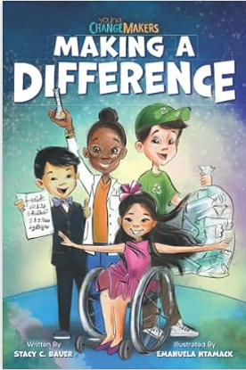
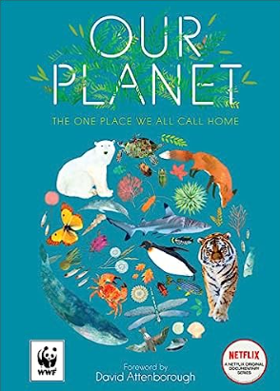

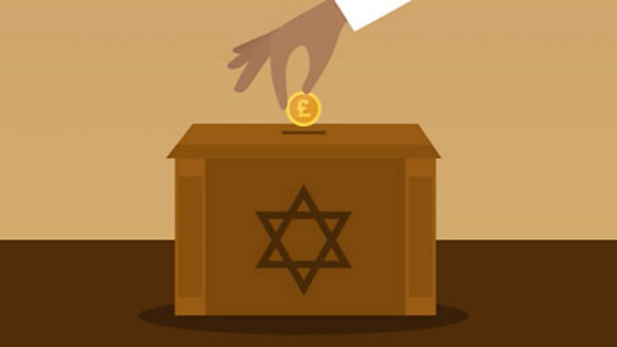
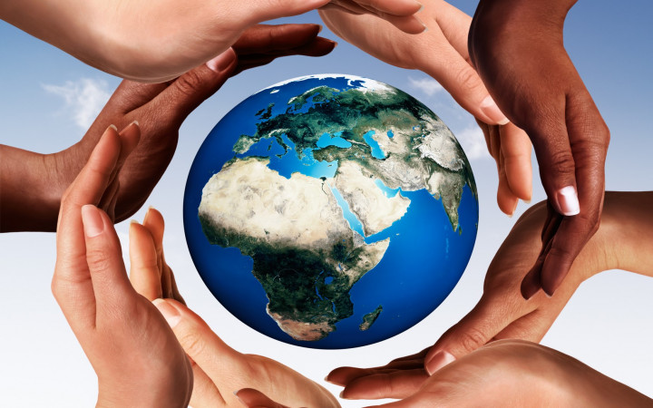
YEAR 3 RE – Summer 2 How and why do people try to make the world a better place?
Tier 3 Vocabulary | Knowledge | Recommended Reads
Commandment- a divine rule, especially one of the Ten Commandments. | Many Christians think: ‘God made the world good and beautiful. Humans are free to choose how to live. This freedom is a gift from God.
Neighbour- anyone who is in need, regardless of religion, race or location. | Most Christians believe that Jesus was not just a good teacher, but that he also sacrificed his life to save humanity. Many Christians try to follow his example by putting the needs of others before their own. Some people do this in world-changing ways.
To treat someone right- how you behave towards someone else
Golden rule- Christian's duty to his neighbour.
 | The Bible says we have spoiled our relationship with God and spoiled the world by making bad choices (called ‘sin’). | Agreed Syllabus Learning Outcomes Make sense of belief: Identify some beliefs about why the world is not always a good place (e.g. Christian ideas of sin). Make links between religious beliefs and teachings and why people try to live and make the world a better place. Understand the impact: Make simple links between teachings about how to live and ways in which people try to make the world a better place (e.g. tikkun olam and the charity Tzedek). Describe some examples of how people try to live (e.g. individuals and organisations. Identify some differences in how people put their beliefs into action. Make connections: Raise questions and suggest answers about why the world is not always a good place, and what are the best ways of making it better. Make links between some commands for living from religious traditions, non-religious worldviews and pupils’ own ideas. Express their own ideas about the best ways to make the world a better place, making links with religious ideas studied, giving good reasons for their views.
tikkun olam- The Hebrew phrase world repair.
 | Tikkun olam means ‘repair the world’. Jewish people try to do this to help people and the world.
Repairing- to restore by replacing a part or putting together what is torn or broken |  | Agreed Syllabus End Points Make sense of belief: • Identify some Jewish beliefs about God, sin and forgiveness and describewhat they mean. • Make clear links between the story of the Exodus and Jewish beliefs about God and his relationship with the Jewish people • Offer informed suggestions about the meaning of the Exodus story for Jews today. Understand the impact: • Make simple links between Jewish beliefs about God and his people and how Jews live (e.g. through celebrating forgiveness, salvation and freedom at festivals) • Describe how Jews show their beliefs through worship in festivals, both at home and in wider communities Make connections: • Raise questions and suggest answers about whether it is good for Jewsand everyone else to remember the past and look forward to the future. • Make links with the value of personal reflection, saying sorry, beingforgiven, being grateful, seeking freedom and justice in the world today,including pupils’ own lives, and giving good reasons for their ideas
 | Tikkun olam can be done in different ways, for example by planting trees, recycling, or visiting people who are unwell or need help.
 | Many Hindus believe that the soul passes through a series of lives with the next lives always being dependent on how the previous ones were lived. Hindus believe that eventually, if someone truly understands atman, does their duty (dharma) and lives a good life (karma), they will achieve moksha, which means release from samsara (the cycle of life, death and rebirth). They will not have to be born again and their atman is released to merge back into Brahman. | Agreed Syllabus End Points Understand the impact: •

