Slide 1
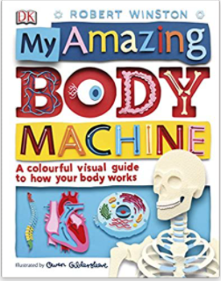
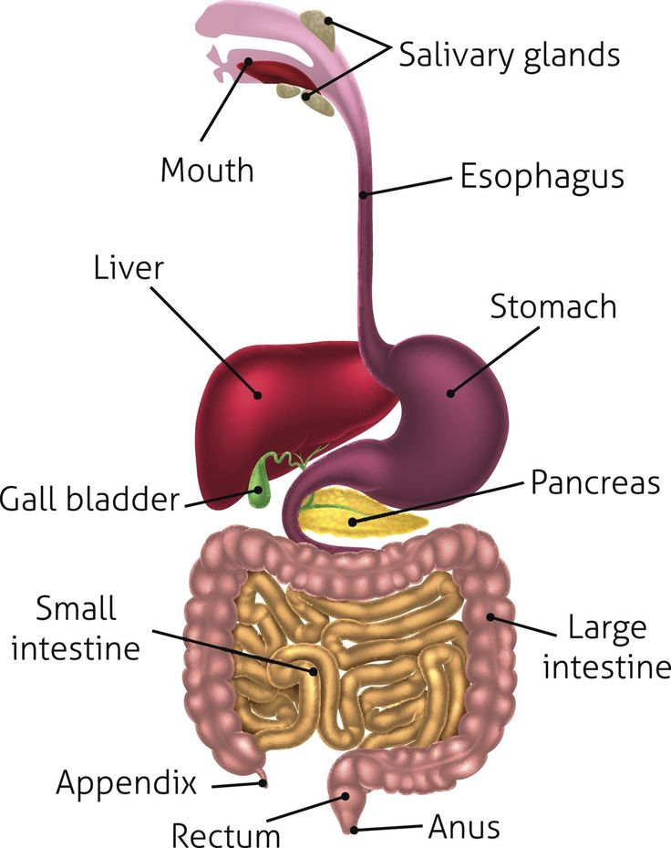
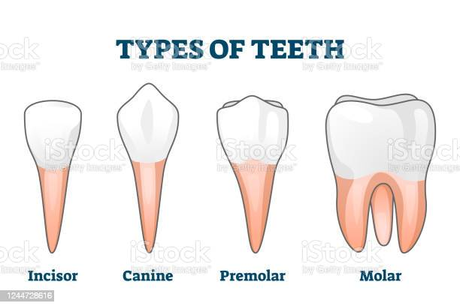
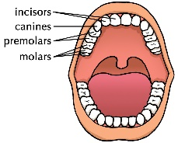
YEAR 4 SCIENCE – ANIMALS, INCLUDING HUMANS: DIGESTIVE SYSTEM & TEETH
Tier 3 Vocabulary | Knowledge Facts | Recommended Reads
Molars- the big, flat teeth at the back of the mouth. | Humans have 4 types of teeth: molars, premolars, canines and incisors. Molars are the big, flat teeth at the back of the mouth. They grind up the food so it is small enough to digest. Incisors are the sharp teeth at the front of the mouth. They bite up lumps of food. Canines are pointed. They rip and tear food. In the past, people used their teeth as tools and if they cleaned them , used sticks. Herbivores have several pairs of broad molars to grind plants and most have no canines. Most carnivores have long, sharp canines and incisors for tearing meat and a few molars at the back of their mouth. Omnivores have molars and wide front teeth like chisels for eating both plants and meat. The digestive system First, you chew food and your tongue pushes it to the back of your mouth. After you swallow, the food moves down your esophagus using a movement called peristalsis. When the food reaches your stomach, the stomach contracts and acid helps break the food down into liquid and small pieces. The food moves into the small intestine and nutrients from the food are absorbed. The last stage of digestion is the large intestine. Any food that the body doesn't need or can't use is sent here and later leaves the body as waste (faeces or poo).
Premolars- the teeth between your canines and molars.
Canines- the pointed teeth either side of the incisors.
Incisors- the sharp teeth at the front of the mouth.
Digest- to break down food so it can be absorbed and used by the body.
Omnivores-animals which eat both plants and meat.
Herbivores-animals which only eat plants. |  | The Digestive System
Carnivores- animals which only eat meat.
Esophagus- a long tube, which leads from our throat to our stomach. Also known as food pipe or gullet.
Stomach- a muscular organ is which the oesophagus leads to. It uses acid to help break down the food you eat, by contracting.
Large intestine - this large tube absorbs water and salts from the material that has not been digested as food, and stores waste as faeces.
Small intestine - a 7m long tube which works with juices from the liver and pancreas to continue to break down our food.
Anus: the opening in your body where faeces passes out of your body. | National Curriculum End Points Describe the simple functions of the basic parts of the digestive system in humans. Identify the different types of teeth in humans and their simple functions.
Faeces- waste produced by the body.
Peristalsis- wave like muscle movements.
contract-tightening and loosening of muscles.
Types
of
Teeth

