Slide 1
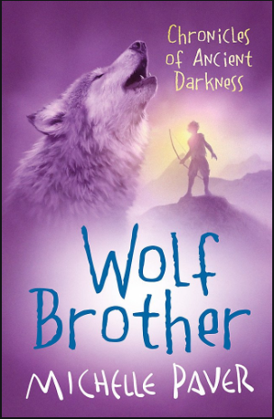
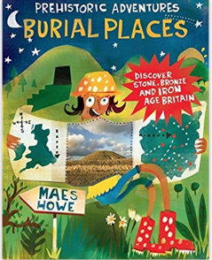
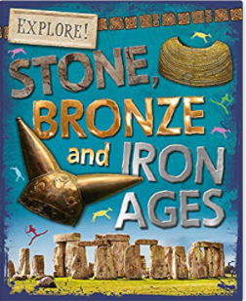
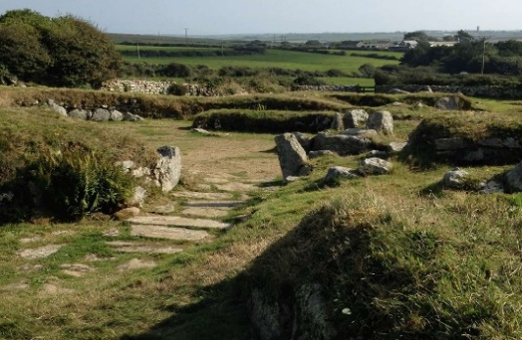
YEAR 4 HISTORY – STONE AGE TO IRON AGE – Autumn 1
Tier 3 Vocabulary | Knowledge Facts | Book Curriculum
Prehistory: human history in the period before recorded (written) events. | The Stone Age was 2.6 million years ago. It is called the Stone Age because early humans started using stone, such as flint, for tools and weapons.
BCE: before common era ( the same as BC: Before Christ)
 | We divide The Stone Age into the Paleolithic Period or Old Stone Age , the Mesolithic Period or Middle Stone Age and the Neolithic Period or New Stone Age.
Neanderthals- the earliest humans
 | We can find out about the Stone Age by looking at artefacts (tools, weapons etc) cave paintings and built structures. Skeletons also tell us about life then.
 |  | Other recommended reads
Artefact- something made or given shape by humans, such as a tool or a work of art, especially an object of archaeological interest
 | The Neolithic era (New Stone Age) began when humans discovered agriculture and raising cattle, which allowed them to no longer have a nomadic life style.
Archaeologist- a specialist in archaeology, the scientific study of prehistoric peoples and their cultures by analysis of their artefacts, inscriptions, monuments, etc. | The Stone Age ended when humans began using metal to work with.
Nomadic- a person who has no fixed, permanent home, moves from place to place, usually depending on the seasons. | In the Bronze Age, copper was the first metal. Soon, copper and tin were mixed to make bronze, a stronger metal. People could now make stronger tools and weapons.
 | During the Iron Age, people developed iron. The people living at this time were called Celts, lived in ‘roundhouses’ and were the first to make chariots, lathes, rotary querns for grinding grain, coins and the potter’s wheel.
Hunter-gatherer- a person who lives by hunting, fishing and foraging. (Finding wild food like fruits and nuts etc.) | Celts traded with the continent, exporting grain, hunting dogs, and horses while importing wine, amber, oil and glass.
Civilisation- an advanced state of human society, in which a high level of culture, science, industry, and government has been reached. | We know life in the Iron Age was very violent, from looking at artefacts and skeletons.
 | National Curriculum End Points Compare how lifestyles changed from Stone Age to Iron Age eg from hunter gathers to life in organised communities. Understand the sources of evidence available and conclusions drawn from them.
Carn Euny Iron Age Village

