Slide 1
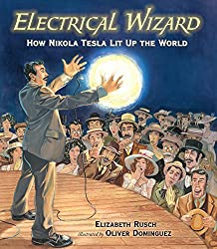
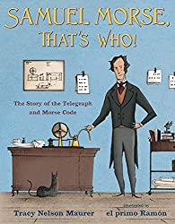
YEAR 3 SCIENCE – Scientists and Inventors – Summer 2
Tier 3 Vocabulary | Knowledge Facts | Recommended Reads
Native plant – a plant that grows naturally | Sir Joseph Banks introduced 80 species of plants, including the eucalyptus and the banksia, which is named after him
 | Marie Curie was a famous scientist who developed the use of x-rays, which meant that a lot more patients could be correctly diagnosed and treated
Non-native plant – a plant that has been brought to a country
 | George Washington Carver came up with more than 100 uses of a peanut so farmers could sell these plants at a higher price. The uses of peanuts included paints, face creams, plastics and medicines
Radiation - Energy released in the form of particle or electromagnetic waves
Molten- something liquified by heat
 | William Smith studied geology and would study the pattern of fossils. He realised that he could tell the age of a rock by looking at fossils
Lava- hot molten rock erupted from a volcano or fissure, or solid rock resulting from cooling of this.
 | Inge Lehmann was a seismologist and looked at the waves of energy caused by earthquakes. She concluded that the earth has a solid core at the centre.
Opaque- Something you cant see through | Electromagnets are made of coils of wire with electricity passing through them. Moving charges create magnetic fields, so when the coils of wire in an electromagnet have an electric current passing through them, the coils behave like a magnet.
Translucent- something you can just see through
 | National Curriculum Objectives Explore the part that flowers play in the life cycle of a flowering plant, including pollinations, seed formation and seed dispersal. Identify that humans and some animals have skeletons and muscles for support, protection and movement. Explore the requirements of plants for life and growth (air, light, water, nutrients from soil, & room to grow) & how they vary from plant to plant. Describe in simple terms how fossils are formed when things that have lived are trapped within rock.
Transparent – Something totally see through
X-ray - an electromagnetic wave which is able to pass through many materials opaque to light.

