Slide 1
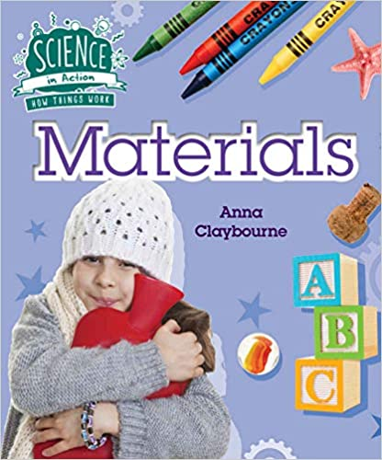
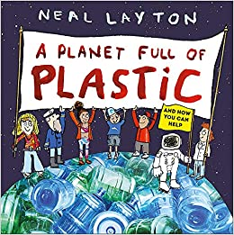
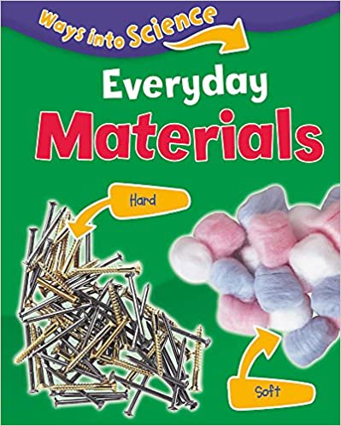
YEAR 1 SCIENCE – EVERYDAY MATERIALS – Autumn 1
Tier 3 Vocabulary | Knowledge Facts | Recommended Reads
Hard – not soft. | The materials are wood, metal, plastic, water, metal, glass and rock. | .
Shiny - reflecting or glowing with light
 | Materials on our school grounds include: plastic, water, metal, rock, glass and wood.
Soft - easy to bend or to shape; not firm or hard.
 | Objects can be made from more than one material. For example: scissors are metal and plastic.
Dull - not shiny or bright
 | Objects that are hard are very solid, rigid or firm. Objects that are soft are pleasant to touch, and not rough or hard.
Properties - Materials can be described by their properties e.g soft, hard, shiny, dull. | Objects that are shiny reflect light. Objects that are dull do not reflect light and do not have a shine to it. | Which of these materials do you use every day?
Water - a colourless, transparent, odourless liquid.
 | National Curriculum End Points I can distinguish between an object and the material from which it is made. I can identify and name a variety of everyday materials, including wood, plastic, glass, metal, water, and rock. I can describe the simple physical properties of a variety of everyday materials. I can compare and group together a variety of everyday materials on the basis of their simple physical properties.
Metal - a solid material
Plastic - a material that contains as an essential ingredient an organic substance of large molecular weight.
Rock - A rock is a solid made up of a bunch of different minerals.
Glass - Glass is easily breakable, but it can also be made very strong. It usually lets light shine through, but it blocks liquids and air.

Slide 2
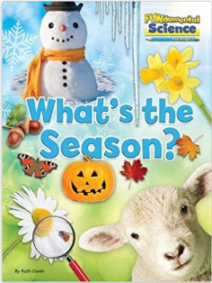
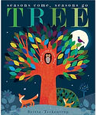
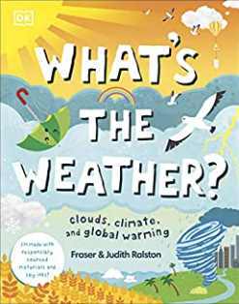
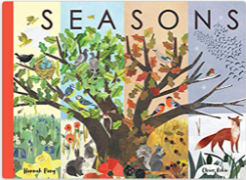
YEAR 1 SCIENCE – SEASONAL CHANGES (AUTUMN & WINTER) – Autumn 2
Tier 3 Vocabulary | Knowledge Facts | Book Curriculum & Recommended Reads
Seasons - This cycle of weather changes is divided into four parts, known as the seasons. The four seasons are winter, spring, summer, and autumn. | There are four seasons. There are 12 months. Each season lasts about 3 months. | .
 | The weather is colder in Autumn. We get more rain and wind. The leaves begin to fall off trees.
 | The seasons are defined as spring (March, April, May), summer (June, July, August), autumn (September, October, November) and winter (December, January, February). Spring and Summer get more daylight.
Months - each of the twelve named periods into which a year is divided.
Weather - Weather is sunshine, rain, snow, wind, and storms. It's what is going on outside right now.
 | A flowering plant has roots, leaves, a stem, and a flower. Most plants have roots.
 | A tree is a plant because it has roots and needs water and sunlight to grown. A tree has roots, a trunk, branches and leaves.
Changes - to make or become different
 | Not every tree loses their leaves in winter. Evergreen trees (cedar, holly) keep their leaves. Deciduous trees (ash, oak, birch) lose their leaves by winter.
Growth - an increase in size.
Structure - something built or arranged in a definite way. | National Curriculum End Points I can observe changes that occur across the four seasons. I can observe and describe weather associated with the seasons and how the day length varies. I can identify and describe the basic structure of a variety of common flowering plants, including trees. I can identify and name a variety of common wild and garden plants, including deciduous and evergreen trees.
 |  | What is the weather like today?
Vary - to change; to make different.
Plants - living things that grow from the soil and turn light from the sun into food.
 | The Seasons
Spring Summer Autumn Winter

Slide 3
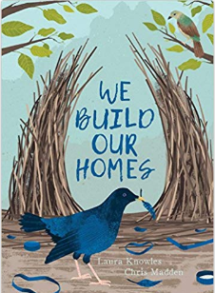
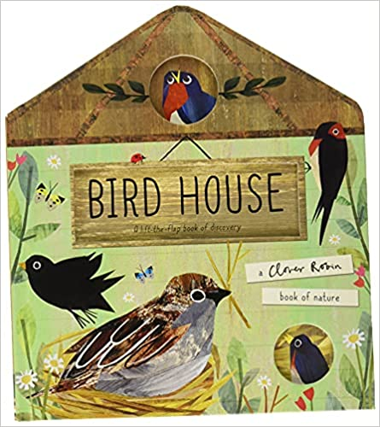
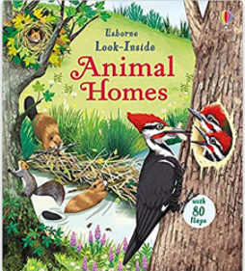
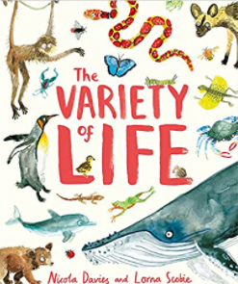
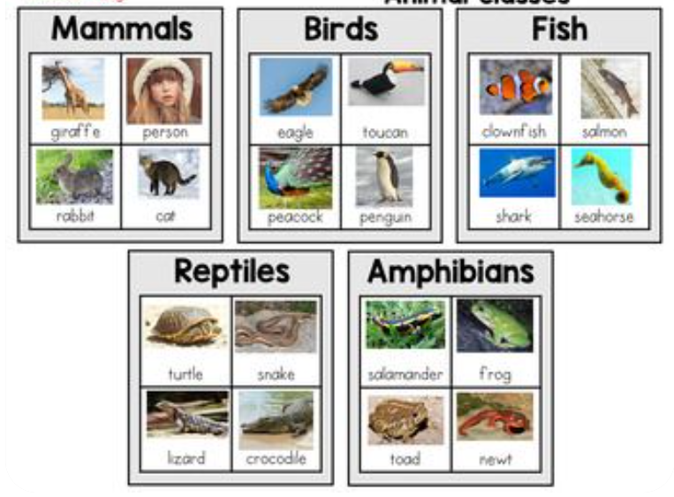
YEAR 1 SCIENCE – ANIMALS – Spring 1
Tier 3 Vocabulary | Knowledge Facts | Book Curriculum & Recommended Reads
Amphibians - a cold-blooded vertebrate animal. They are distinguished by having an aquatic gill-breathing larval stage followed (typically) by a terrestrial lung-breathing adult stage. | In Winter it is cold. Sometimes it might snow. It is darker in Winter because we get less daylight. | .
 | A bird has wings, a beak, feathers, a tail and claws. Some common birds include; a robin, a herring gull, a sparrow, a blackbird, a blue tit and a parrot.
 | A fish has a fin, scales, tail and gills. Some common fish include: cod, goldfish, Tuna and salmon.
Reptiles - a vertebrate animal. They are distinguished by having a dry scaly skin and typically laying soft-shelled eggs on land.
 | A reptile is a cold blooded animal. They can vary in the way the look. They do not have fur or feathers but they do have scales. They include; snakes, lizards and crocodiles.
Mammals - a warm-blooded vertebrate animal of a class that is distinguished by the possession of hair or fur, females that secrete milk for the nourishment of the young, and (typically) the birth of live young.
 | Amphibians are small vertebrates that need water, or a moist environment, to survive. Amphibians are also characterised by their smooth, slimy skin and their lack of scales, feathers or hair. They include: toads, frogs, newts and salamanders.
 |  | What animals do you know?
Structure - something built or arranged in a definite way. | A mammal is an animal that breathes air, has a backbone, and grows hair at some point during its life. In addition, all female mammals have glands that can produce milk. ... Mammals include a wide variety of animals, from cats to humans to whales.
Common - shared together.
Variety - a collection of different things. | National Curriculum End Points I can identify and name a variety of common animals including fish, amphibians, reptiles, birds and mammals. I can describe and compare the structure of a variety of common animals (fish, amphibians, reptiles, birds and mammals, including pets)
Characteristics - a typical or special quality of a person, group, action, or thing

Slide 4
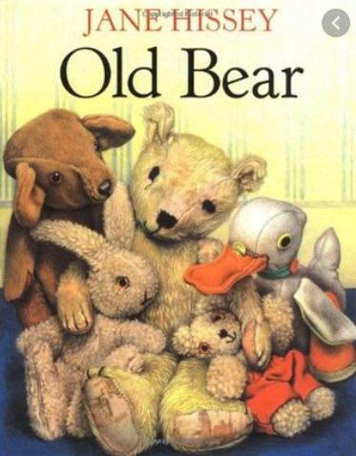
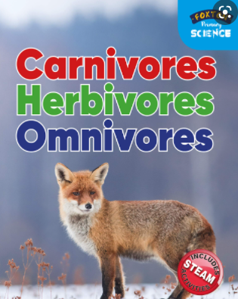
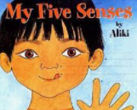
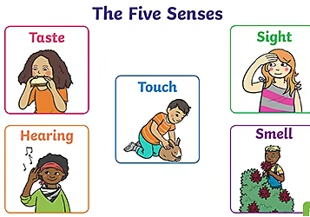
YEAR 1 SCIENCE – SENSES and our bodies– Spring 2
Tier 3 Vocabulary | Knowledge Facts | Book Curriculum & Recommended Reads
Senses - what help us to understand and interact with the world we live in. | The weather is spring starts to get warmer. The days start to longer and we get more daylight than autumn and winter. | .
Human body - The human body is the body of a person.
 | A human body has a head, eyes, ears, nose, mouth, ears, arms, shoulder, elbow, hand, fingers, body, legs, knee, feet and toes.
Taste – a person's like or dislike for particular flavours.
 | Our eyes help us to see. They are important because they help us to see the world around us. Our ears help us to hear.
Smell - noticing smells or scents by means of the organs in the nose.
 | Taste buds are found on your tongue and allow you to experience tastes that are sweet, salty, sour, and bitter. We use our nose to smell things.
Touch - our skins can detect a wide range of different textures and temperatures.
 | Our skin helps us to feel the sense touch. Skin is the largest organ as it is found throughout the human body.
Hear - to be able to become aware of sound
 | National Curriculum End Points I can identify, name, draw and label the basic parts of the human body and say which part is associated with each sense.
Sight - the ability to see; vision.
Carnivores - an animal or human that eats meat.
Herbivores – an animal or human that eats plants.
Omnivores – an animal or human that eats both meat and plants.

Slide 5
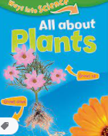
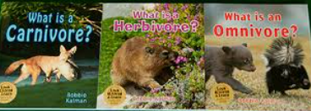
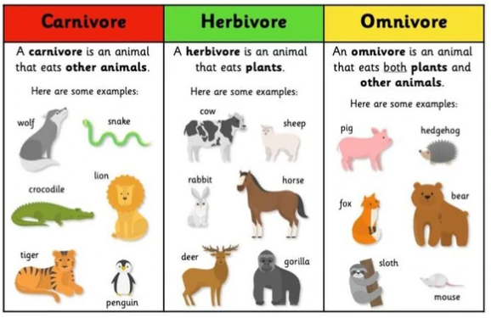
YEAR 1 SCIENCE – Plants and animals
Tier 3 Vocabulary | Knowledge Facts | Book Curriculum & Recommended Reads
Roots - the part of a plant which attaches it to the ground or to a support, | A carnivore is an animal which eats only meat. Some include; lions, tigers and lizards.
Seeds - A seed contains a miniature plant, called an embryo, that can develop into a fully grown plant.
 | A herbivore is an animals that eat only plants or plant products. Some include; horses, cows and goats.
Structure - something built or arranged in a definite way
 | Omnivores are animal that feeds on plants and other animals. Some include; dogs, cats and crows.
Flowering - in bloom
 | All plants needs light, water and air to grow. They all have roots and start from a seed.
Naturally - without special intervention; in a natural manner.
 | A wildflower is any type of flower that grows naturally in the wild. Common wild flowers near us include; dandelion, forget me not, bluebells and daisies.
Common – something shared together or well known.
 | National Curriculum End Points I can identify and name a variety of common animals that are carnivores, herbivores and omnivores. I can identify and describe the basic structure of a variety of common flowering plants, including trees. I can identify and name a variety of common wild and garden plants, including deciduous and evergreen trees.

