Slide 1
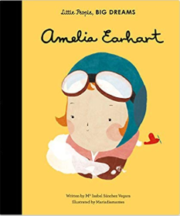
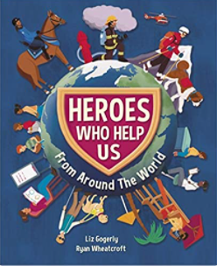
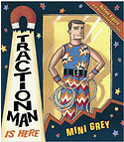
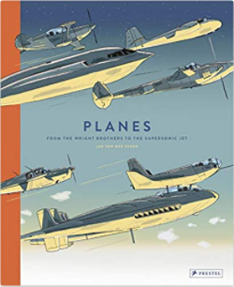
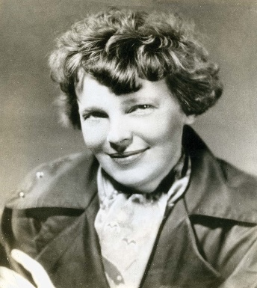
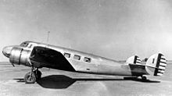
YEAR 1 HISTORY – AMELIA EARHART – Autumn 1
Tier 3 Vocabulary | Knowledge Facts | Book Curriculum
History - is the study of past events. | Amelia Earhart was famous for being the first female to fly solo across the Atlantic Ocean.
Timeline - A timeline is a tool that organises information. It is used to describe the order in which events happened.
 | Questions led by children.
Past - relating to a time that has gone by.
Present - existing or occurring now. | Amelia Earhart was alive from 1897-1939. She was born in 1897. Amelia took her first flying lesson in 1921. In 1932 she flew solo across the Atlantic Ocean. In 1937 Amelia disappeared. Amelia was officially declared dead in 1939.
 |  | Other Recommended Reads
Event - An event is usually an important happening or has happened, | Amelia spent a lot of time growing up with her sister. They had a lot of adventures and spent time outside. They did not have computers or Ipads like we do now so spent a lot of time exploring and playing outside.
Memorable - easily remembered; distinct or exceptional. | Amelia was famous for being a female aviator. Amelia wanted to prove that women could fly and become whatever they want to be.
 | Amelia Earhart was a strong, independent women who made an impact on todays society by being the first woman to fly solo across the Atlantic Ocean.
Significant – something important. | National Curriculum End Points I can use stories and other sources of evidence to understand key achievements of people from history. I can explain understanding of sources of evidence using phrases such as ‘we know this because…’. I can order events and objects, using a timeline to show understanding of past and present. | Amelia Earhart 1897 - 1939
Place – to put it down in a certain area.
Diary - a book for keeping a record of experiences and thoughts.
Famous - known about by many people.

Slide 2
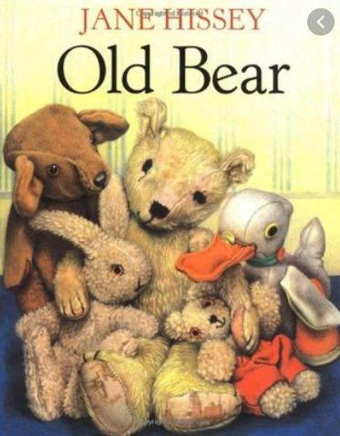
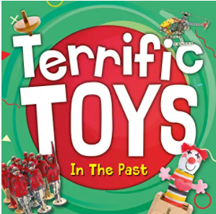
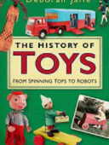
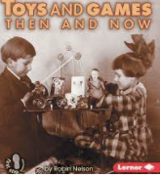
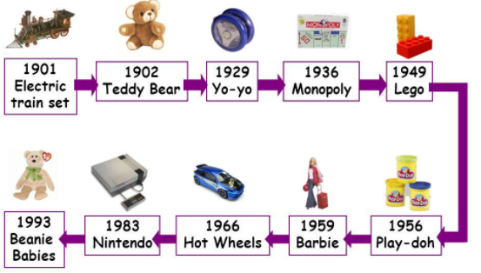
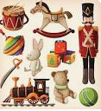
YEAR 1 HISTORY – TOYS – Spring 2
Tier 3 Vocabulary | Knowledge Facts | Book Curriculum
Timeline - A timeline is a tool that organises information. It is used to describe the order in which events happened. | My toys are usually made from plastic or are electrical. The toys from the present are mostly made in a factory.
 | My grandparents toys were usually made from wood or metal. A lot of toys were usually hand made.
Event - An event is usually an important happening or has happened,
 | Place the toys on a timeline. Order them from the oldest toys created to the most recent toys created.
 |  | Other Recommended Reads
Artefacts - an object made by a human being, typically one of cultural or historical interest.
 | Toys in the past were usually made from wood, metal, glass and fabric. Toys made in the present are often made from plastic or they are electrical and need batteries.
Creation - the action or process of bringing something into existence.
 | Toys have changed over time. There are many differences between toys of the past and present including: the materials used, how they are played with and rules for how toys need to be made.
Modern - relating to the present or recent times as opposed to the remote past.
 | National Curriculum End Points I can compare my toys with that of my grandparents using historical language; by looking at artefacts, listening to people and asking questions. I can order events and objects, using a timeline to show understanding of past and present.
Inventions - the action of inventing something, typically a process or device
Materials - the matter from which a thing is or can be made.

Slide 3
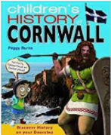
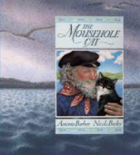
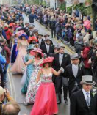
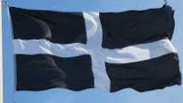
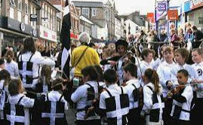
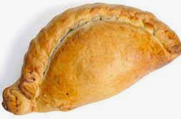
YEAR 1 HISTORY – Cornish events – Summer 1
Tier 3 Vocabulary | Knowledge Facts | Book Curriculum
Event - An event is usually an important happening or has happened, | Cornwall has lots of things that are special to different people. They include; pasties, Cornish flag, beaches and coastlines.
 | St Piran is the Patron Saint of Cornwall and is celebrated on 5th March every year.
Inventor - a person who makes new inventions, devices that perform some kind of function.
 | Flora Day is in Helston every year to celebrate the start of Spring.
 |  | Other Recommended Reads
Locality - a place and its surroundings.
 | Trevithick day is named after Richard Trevithick. Richard Trevithick was the first person to invent a steam engine. He is from Illogan.
Celebrate - to make special or honour with gifts, parties, or activities.
 | Murdoch day was named after William Murdoch. William improved the efficiency of steam engines in Cornwall’s tin mines. He was also a pioneer of gas lighting.
Invent - to think of, come up with, or create something new.
 | National Curriculum End Points To recognise significant historical events, people and places in their own locality:
Pioneer - a person who begins or helps develop something new

