Slide 1
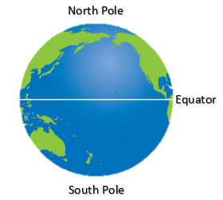
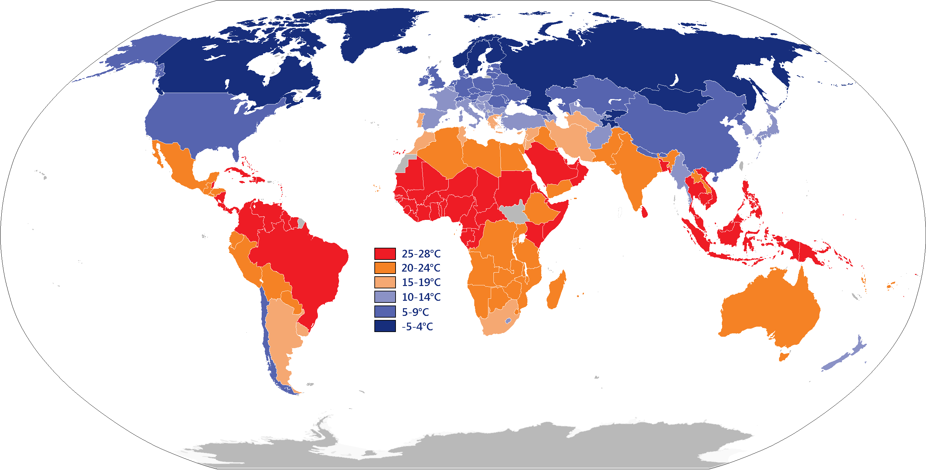
YEAR 1 GEOGRAPHY – HOT AND COLD PLACES
Tier 3 Vocabulary | Knowledge Facts | Book Curriculum
Sea - Seas are smaller than oceans and are usually located where the land and ocean meet. | The world is made up of land, sea and ice.
 | The North Pole is at the top of the world. The South Pole is at the bottom of the world. The equator is the invisible line around the middle of the world.
Land - the solid part of the earth's surface.
 | The weather is different because the poles are cold and the equator is hot.
Ice - frozen water.
 | The weather in the poles are cold and you need to wear warmer clothing. The weather near the equator is hot and you can wear lighter clothing. | Other recommended reads
Earth – Earth is one of the eight planets that orbit, or travel around, the Sun in the solar system. | The similarities in environments for Antartica and the Sahara desert include; sunlight, not many people live there, The differences in environments: Antartica – cold, ice, water. Sahara desert – hot, sand, no water, sand dunes.
Equator - An equator is an imaginary line around the middle of a planet.
 | National Curriculum End Points I can identify the North Pole, South Pole and Equator on a map/globe. I can understand that the Poles are cold areas of the world and that the Equator is hot.
North Pole - The North Pole is the point that is farthest north on the planet Earth.
South Pole - the most southern point of the earth.
Hot – having a high degree of heat or a high temperature.
Cold - a condition of low temperature

Slide 2
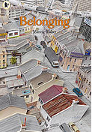
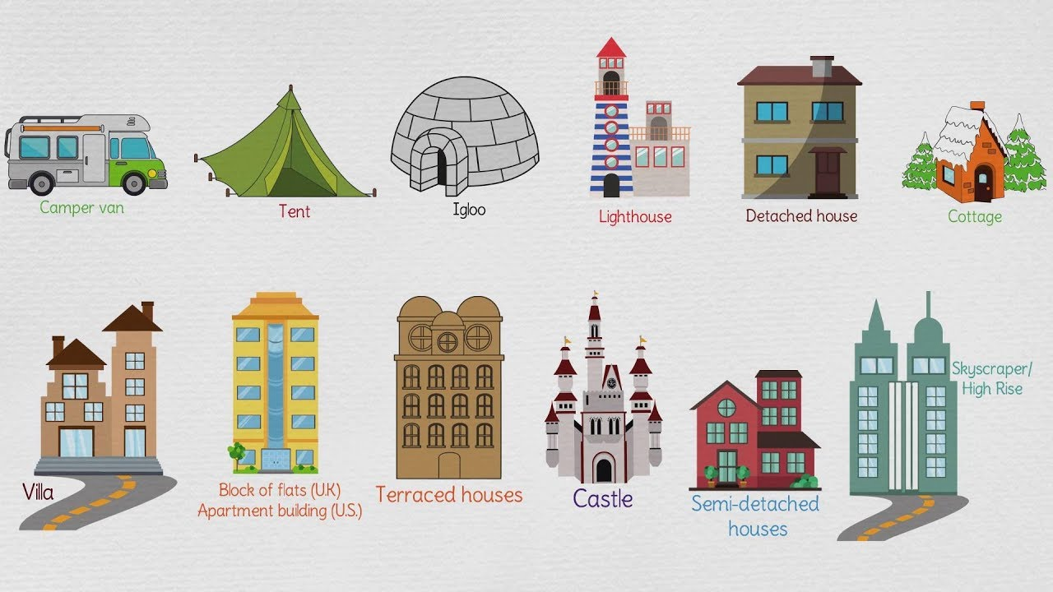
YEAR 1 GEOGRAPHY – OUR HOME: WHERE DO WE LIVE?
Tier 3 Vocabulary | Knowledge Facts | Book Curriculum
Human features - Been built by humans, e.g roads, buildings, bridges. | The Local area is a well defined area such as a village or town. Not all homes are the same. Different places in the world make their houses from different materials.
 | Physical features in the local area include; hills and woodland. Human features in the local area include; shops, pubs, schools, parks, farm.
Physical features - are natural, they would be here if no people were around – e.g seas, mountains
 | Maps lead you to a destination. Being able to use the different features of the local area to help plot a route.
Ariel view - to look at something. from above. |  | Other recommended reads
 | *Fieldwork* Use a simple map to get to the chosen destination.
Country - A country is land that is controlled by a single government
 | The four countries of the UK are England, Scotland, Northern Ireland and Wales.
Area – the amount of space taken up by a shape or surface.
 | The five oceans are the Pacific, Atlantic, Indian, Southern and Artic.
Address - the directions for delivery placed on post.
 | National Curriculum End Points I can name, locate and identify characteristics of the four countries and capital cities of the United Kingdom and its surrounding seas. Use world maps, atlases & globes to identify the UK and its countries (& Europe). I can devise a simple map; and use and construct basic symbols in a key. I can use aerial photographs and plan perspectives to recognise landmarks and basic human and physical features; Use simple fieldwork and observational skills to study the geography of their school and its grounds and the key human and physical features of its surrounding environment. I can use basic geographical vocabulary to refer to key physical features: beach, cliff, coast, forest, hill, mountain, sea, ocean, river, soil, valley, vegetation, season and weather; key human features, including: city, town, village, factory, farm, house, office, port, harbour and shop.
Locate - to find the position or place of.
 |  | Types of homes
Map - a drawing of all or part of Earth's surface
Postcode - a set of numbers or letters and numbers used by a post office to help identify where a letter or parcel should be sent
Direction - to identify where things are in relation to other things

Slide 3
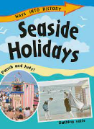
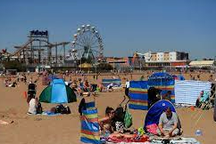
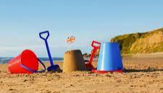
YEAR 1 GEOGRAPHY – Seaside and coastal features
Tier 3 Vocabulary | Knowledge Facts | Book Curriculum
Human features - Been built by humans, e.g roads, buildings, bridges. | The beach is the shore of the water. It is normally sandy or pebbly. A seaside is the area by and around the sea including the beach, promenade, shops etc..
Physical features - are natural, they would be here if no people were around – e.g seas, mountains
 | Physical features of the seaside include: ocean, cliffs, rock pools and sand.
Ariel view - to look at something. from above.
 | Human features of the seaside include: shops, town, piers, beach huts, harbour and amusements.
Country - A country is land that is controlled by a single government. |  | Other recommended reads
 | Lanner is a town that has shops, parks, schools, houses, hills and a quarry. Portreath has a seaside, shops, pier, surf club hut, houses, school and hills.
Area – the amount of space taken up by a shape or surface. | Lifeguards are on the beach to keep us safe on the beach and in the water. The different flags let me know where I can swim (red and yellow), where I cannot swim(red) and where I can surf(black and white). Lighthouses help boats to stay safe in the water and make sure they do not get too close to the coastline.
Beach - the shore of the water. It is normally sandy or pebbly.
Seaside - the area by and around the sea including the beach, promenade, shops etc.. | National Curriculum End Points I can study a coastal village and explore human features such as shop, harbour, village, farm, house, office, hotel Identify physical features within their locality eg beach, cliff, coast, sea, ocean, hill. I can find similarities and differences between two different places.
Coastline - The area where the sea and land meet

